Slide 1
DigiPi by KM6LYW
John Stephens / KC3FDL
Carroll County Amateur Radio Club

Slide 2
What is DigiPi?
“DigiPi is an easy-to-use amateur radio data transceiver hotspot for Raspberry Pi. All radio data modes are easily accessible over wifi via your phone or web browser. Make FT8, JS8Call, APRS and packet modes work like any other mobile phone app. Hookup a DigiPi to your rig and instantly have access to radio SMS, EMail, and texting. Ultra-light, low-power makes it indispensable for Summit and Park operations.
Let's make Ham radio relevant in the information age!” (DigiPi.org)

Slide 3
If you bought an SD card….
Your SD card is 8GB in size and contains a file digipi-2.0-1.img (5.8Gb)
Copy the file to your computer and put it in a safe place. You will probably need it several times.
On your computer, go to https://www.raspberrypi.com/software/ and download and install the Raspberry Pi Imager software. (YES, Seriously…)
Use the Raspberry Pi Imager software to create a bootable Digipi SD card (over and over and over again….)
If you are really savvy, you can create a bootable SSD drive or external flash / hard drive….

Slide 4
Setup Process
Assemble Hardware
Image SD Card
Set up Wifi - Reboot
Initial Configuration - Save Configuration / Reboot
Make File System Read / Write (RW) - Reboot
Set Time / TimeZone
Expand File System - Reboot
Configure Radios - Save Configuration

Slide 5
Requirements
Raspberry Pi (Pi Zero 2 Wireless, Pi3, Pi4, Pi5)
Radio Interface board if required: DigiRig, DigiPi Hat, fe-pi, DRA-Pi-Zero
A USB cable for radios which support cat/rig control and audio over USB
An optional LCD display (1.3" LCD Display)
Micro SD Card 8Gb+
GPS Dongle (optional, but recommended)
Raspberry Pi Imager (https://www.raspberrypi.com/software/)

Slide 6
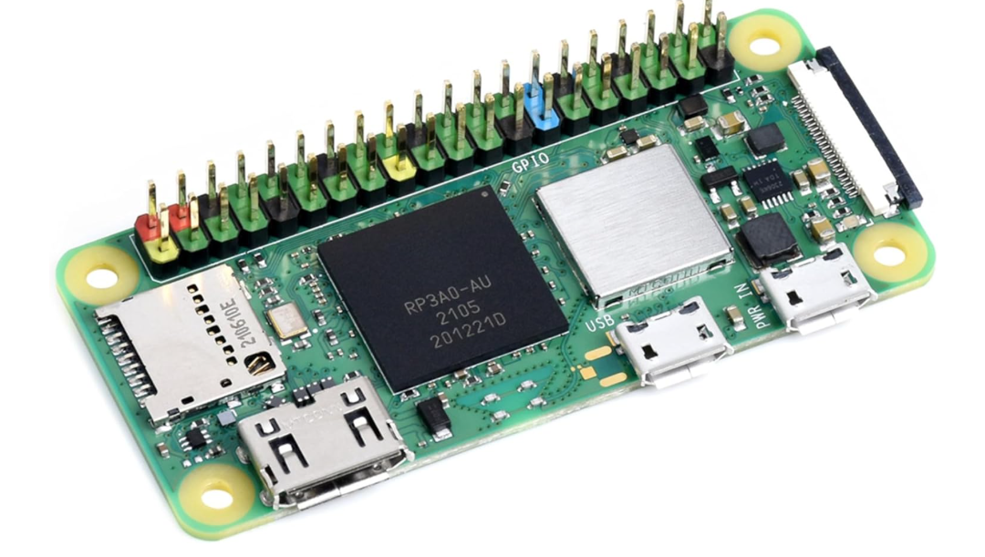

Slide 7
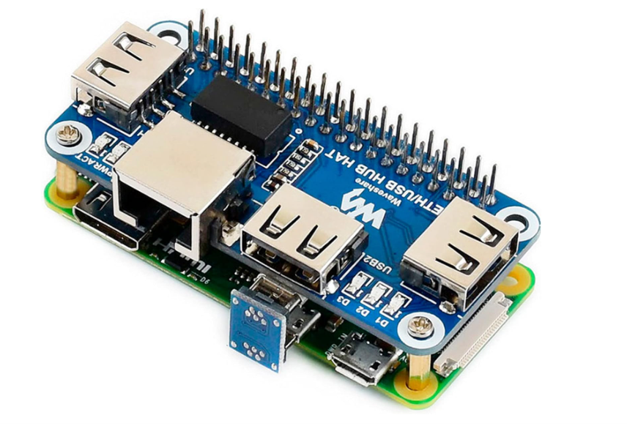

Slide 8
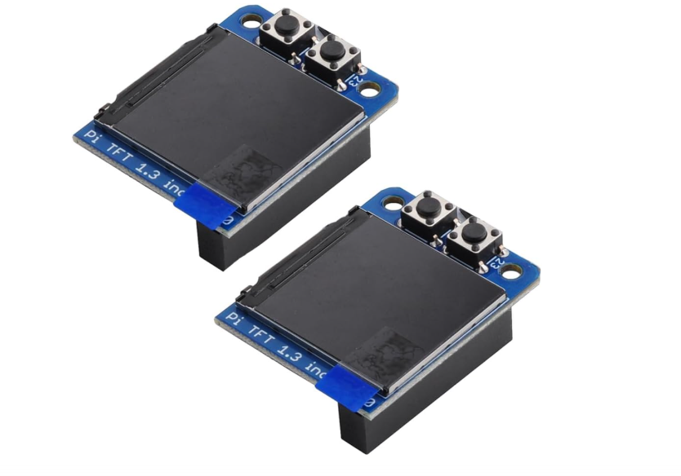

Slide 9
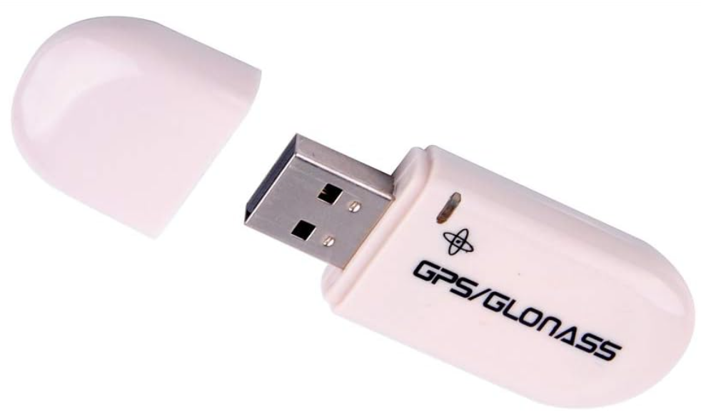

Slide 10
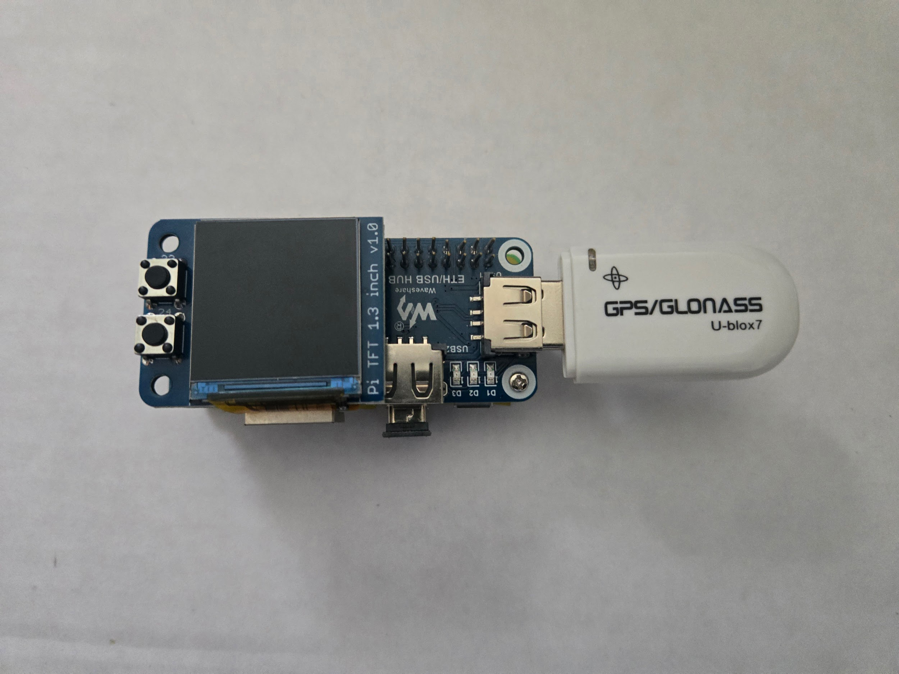

Slide 11
Setup Process
Assemble Hardware
Image SD Card
Set up Wifi - Reboot
Initial Configuration - Save Configuration / Reboot
Make File System Read / Write (RW) - Reboot
Set Time / TimeZone
Expand File System - Reboot
Configure Radios - Save Configuration

Slide 12
Raspberry Pi Imager Software
https://www.raspberrypi.com/software/

Slide 13
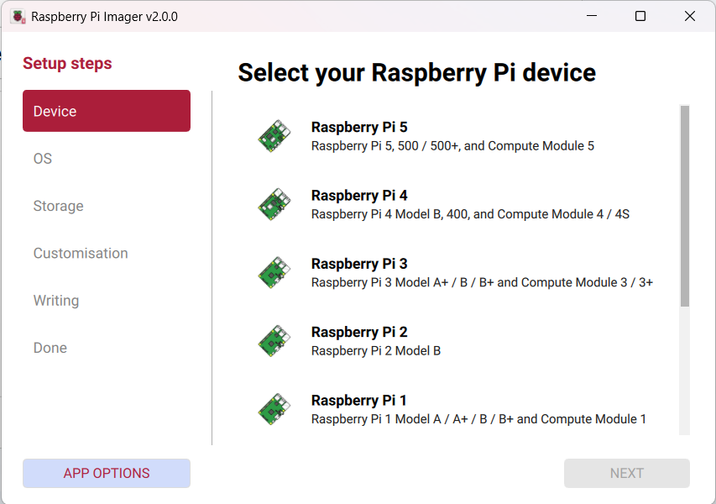

Slide 14
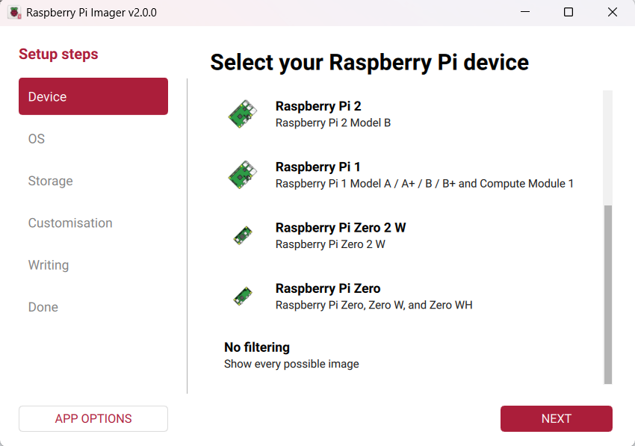

Slide 15
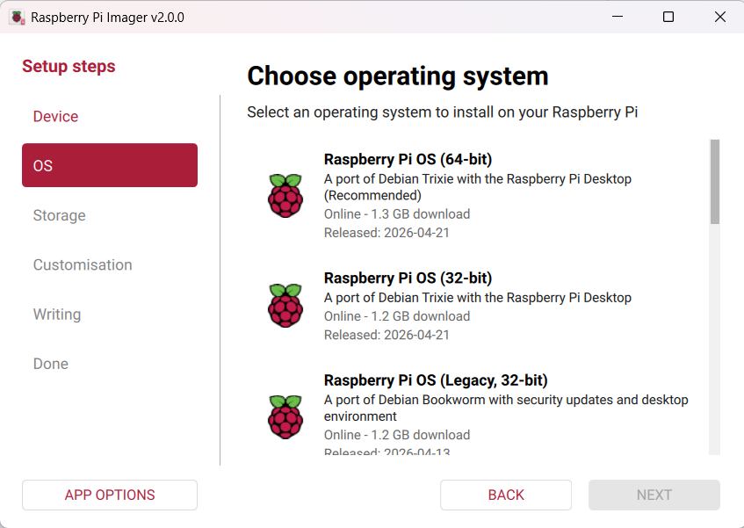

Slide 16
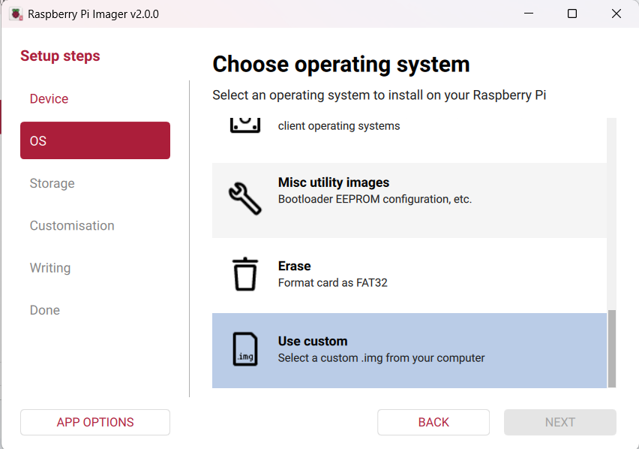

Slide 17
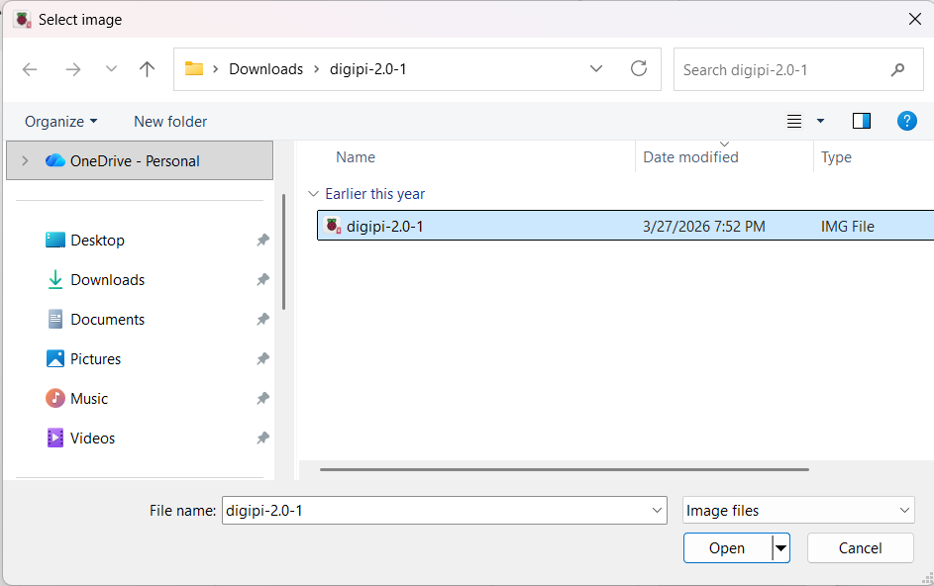

Slide 18
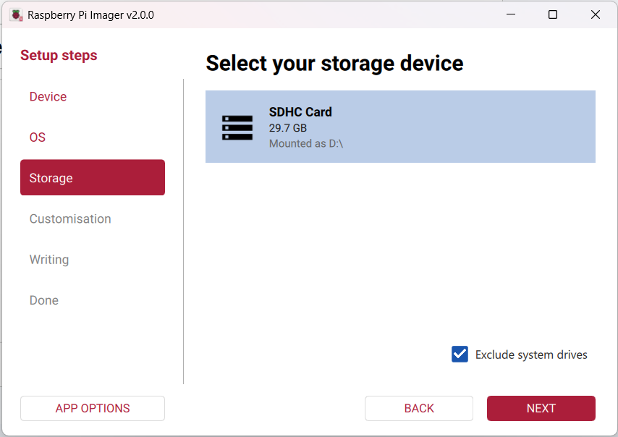

Slide 19
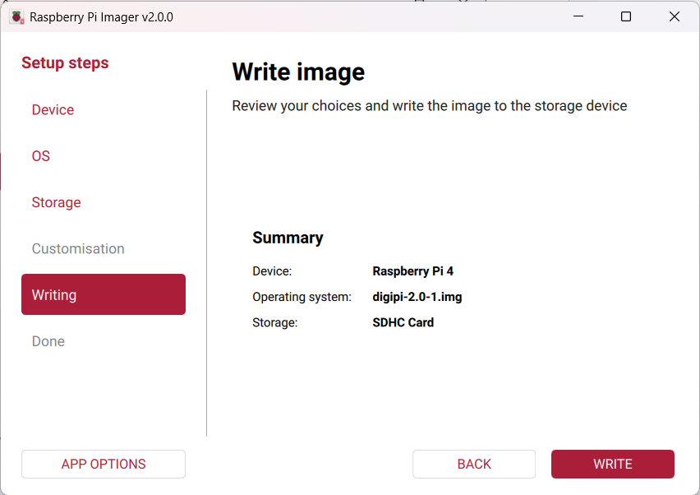

Slide 20
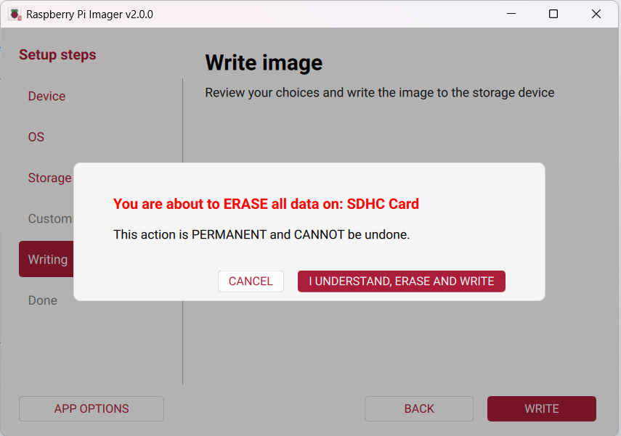

Slide 21
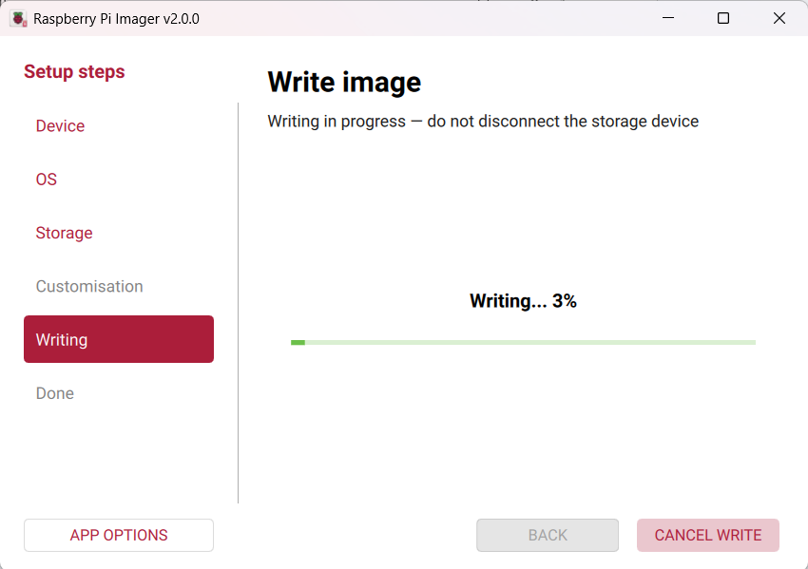

Slide 22


Slide 23
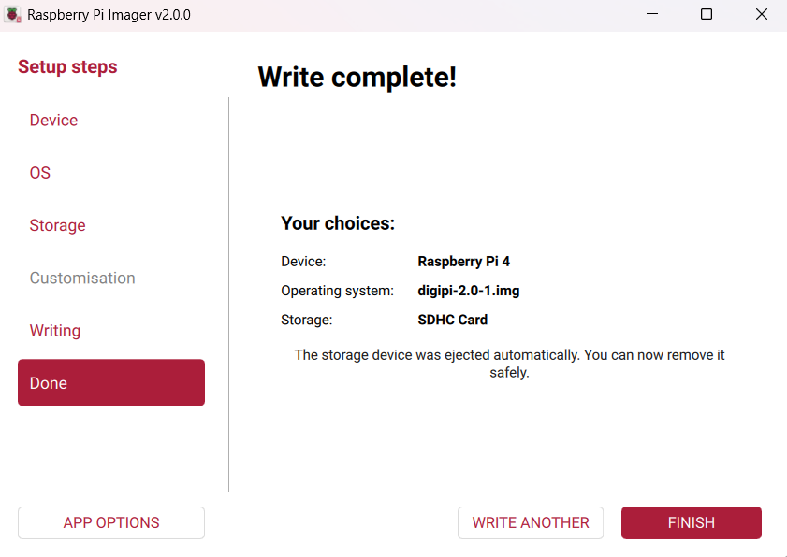

Slide 24
Setup Process
Assemble Hardware
Image SD Card
Set up Wifi - Reboot
Initial Configuration - Save Configuration / Reboot
Make File System Read / Write (RW) - Reboot
Set Time / TimeZone
Expand File System - Reboot
Configure Radios - Save Configuration

Slide 25
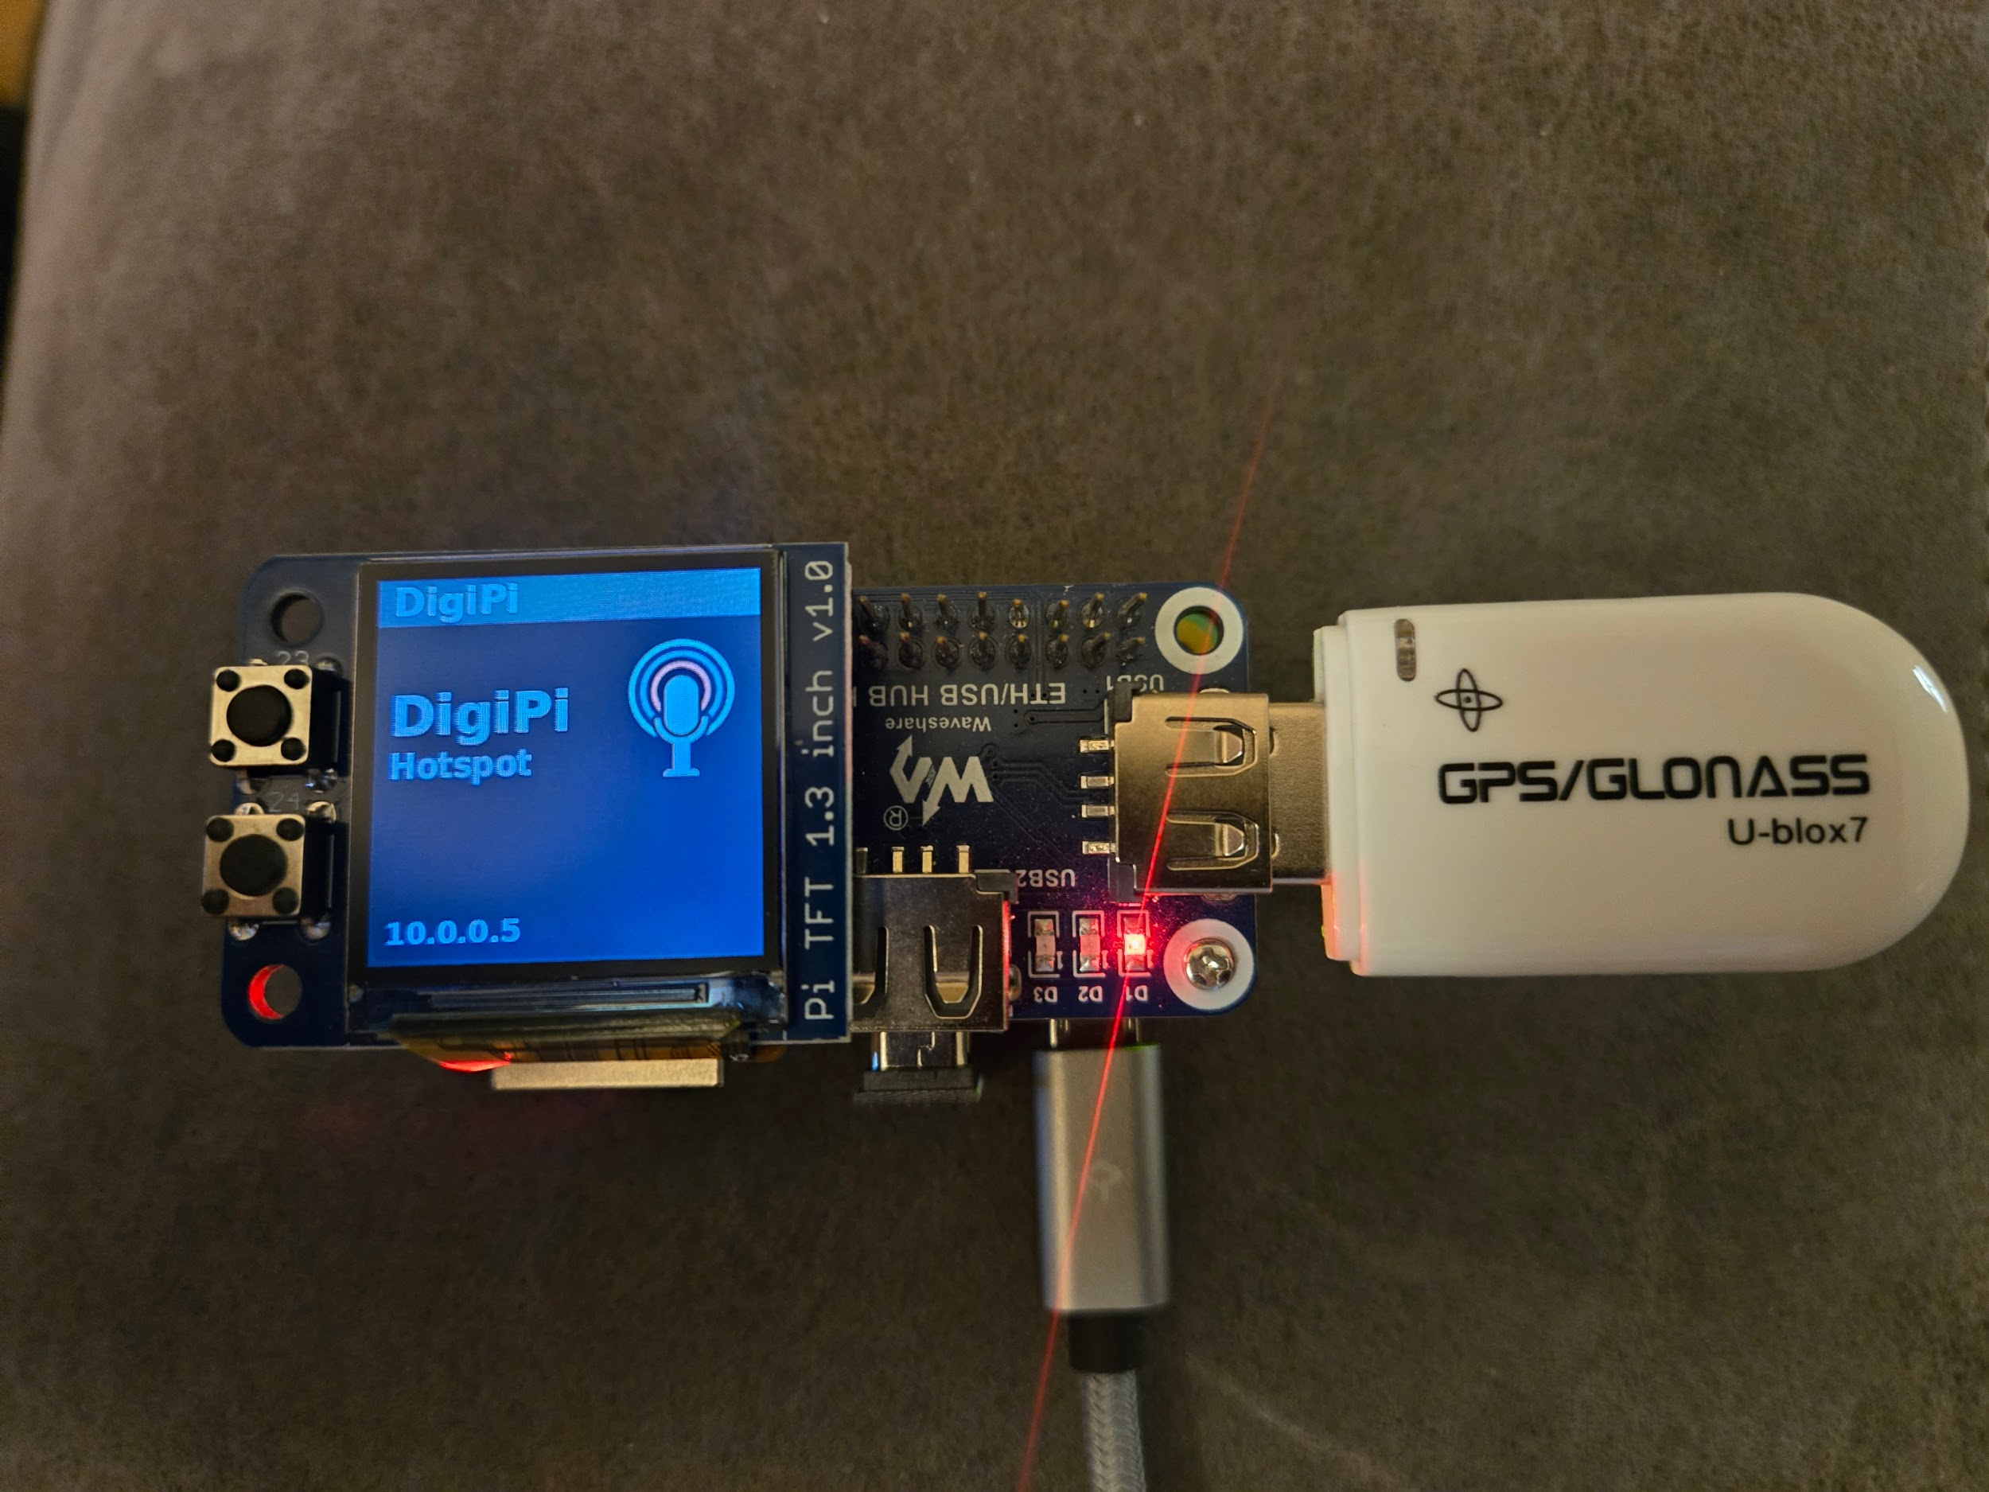
Initial Boot !
Plug in / power up RPI.
Wait a few minutes ( everyone hum the Jeopardy theme song…)
Using a computer, table, phone etc, connect to DIGIPI wifi hotspot
Using browser, navigate to 10.0.0.5/wifi.php

Slide 26
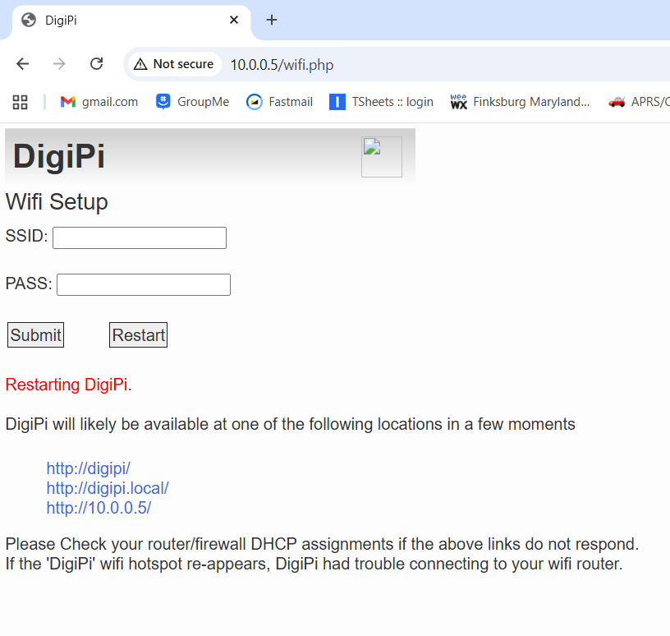
Enter SSID & password
Press “Submit”
Press “Restart”

Slide 27
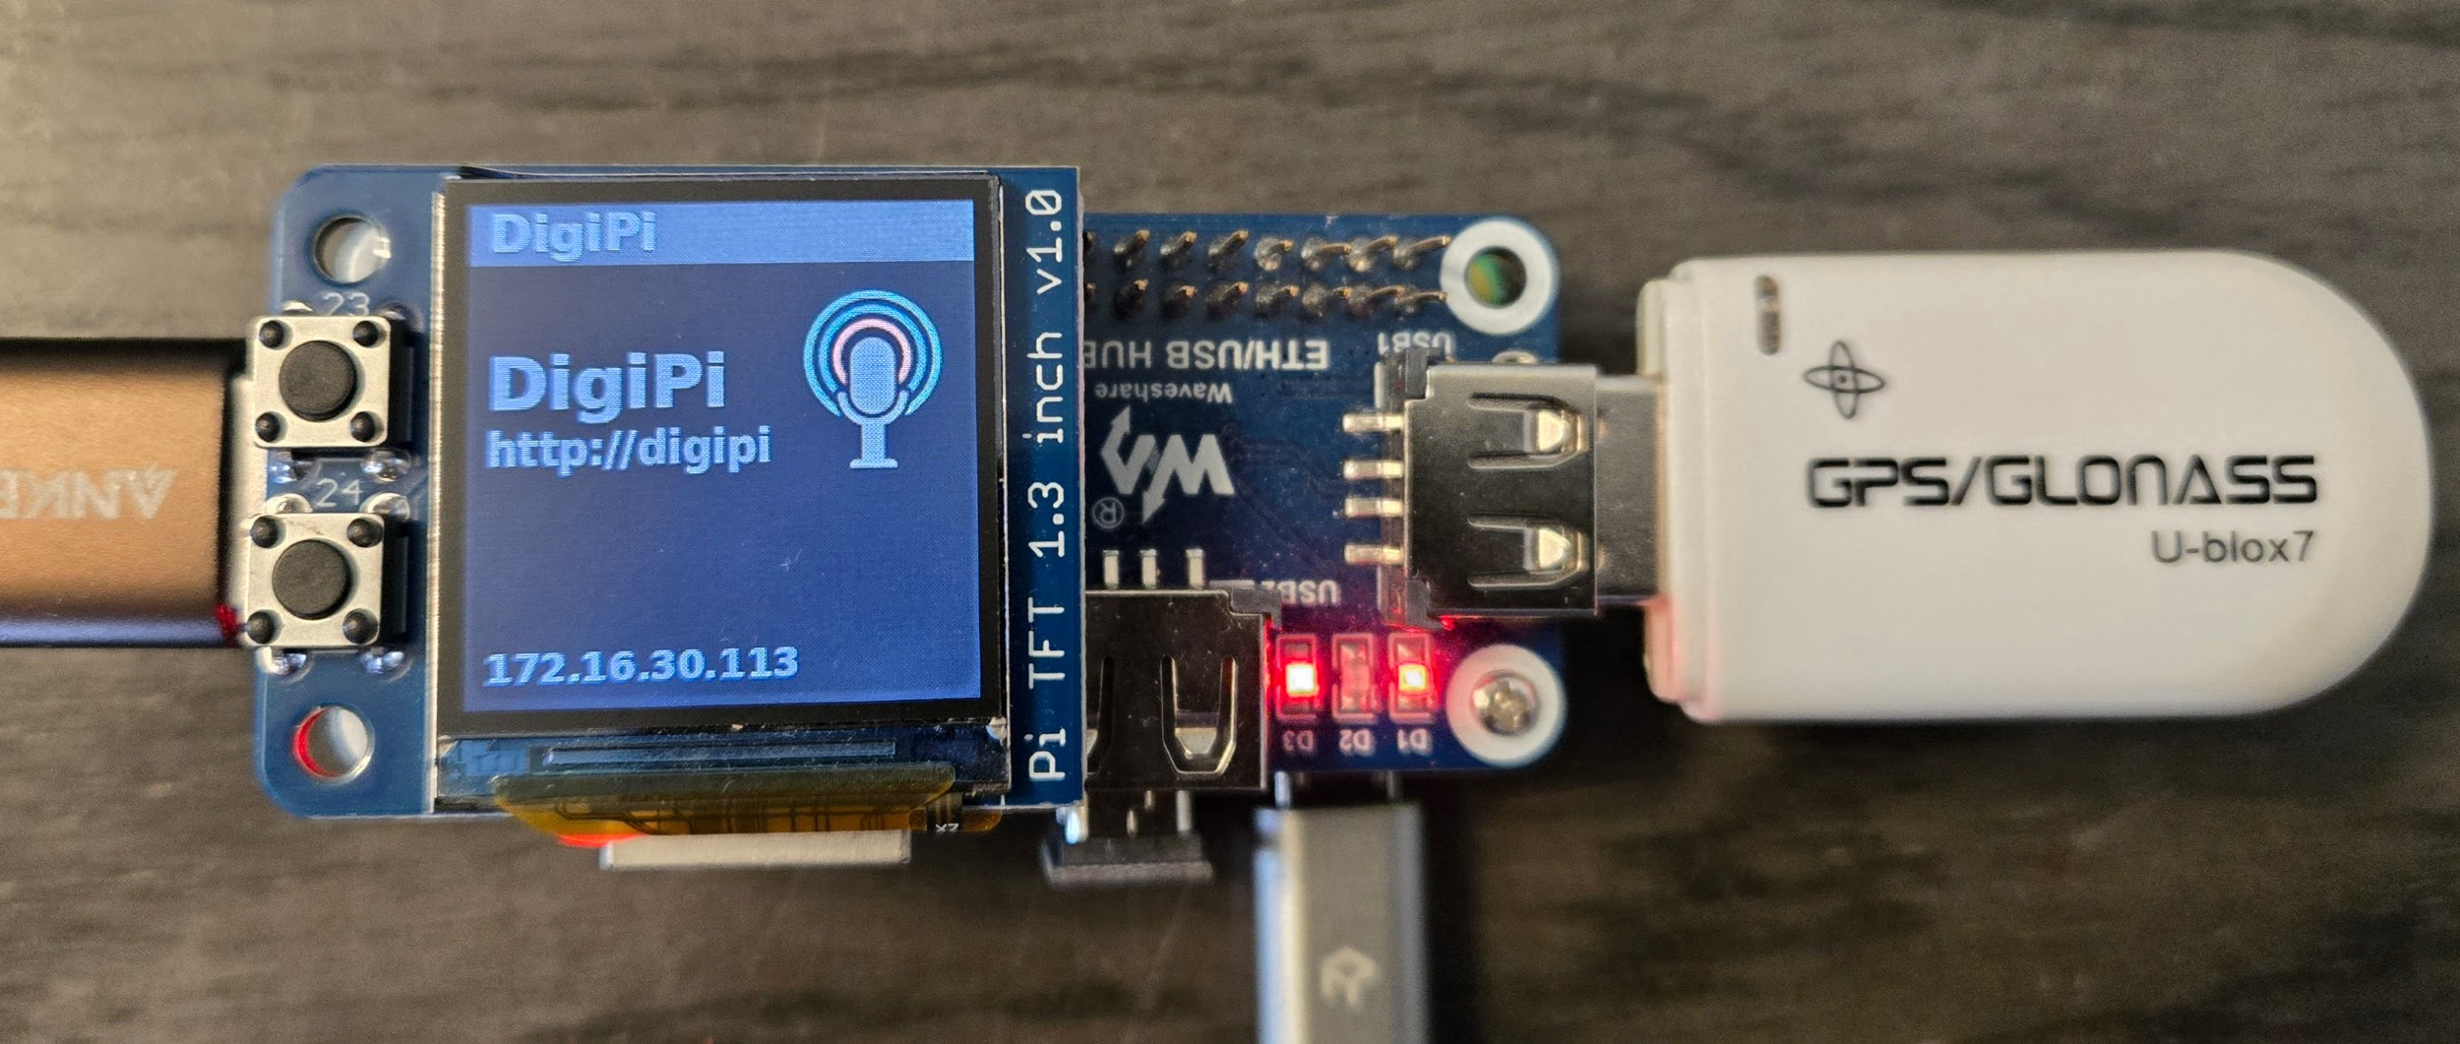

Slide 28
Setup Process
Assemble Hardware
Image SD Card
Set up Wifi - Reboot
Initial Configuration - Save Configuration / Reboot
Make File System Read / Write (RW) - Reboot
Set Time / TimeZone
Expand File System - Reboot
Configure Radios - Save Configuration

Slide 29
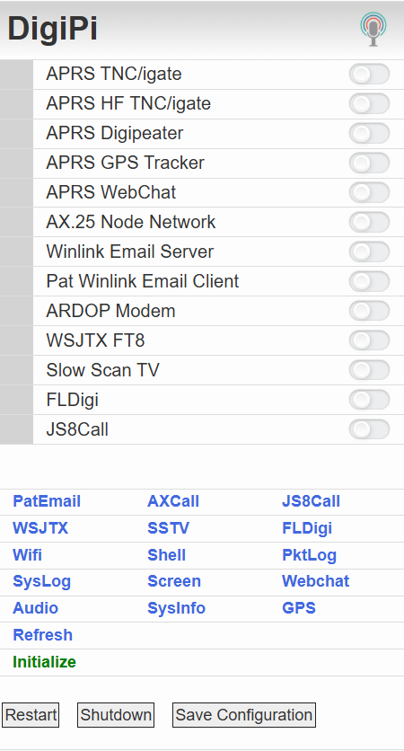
Select: Initialize

Slide 30
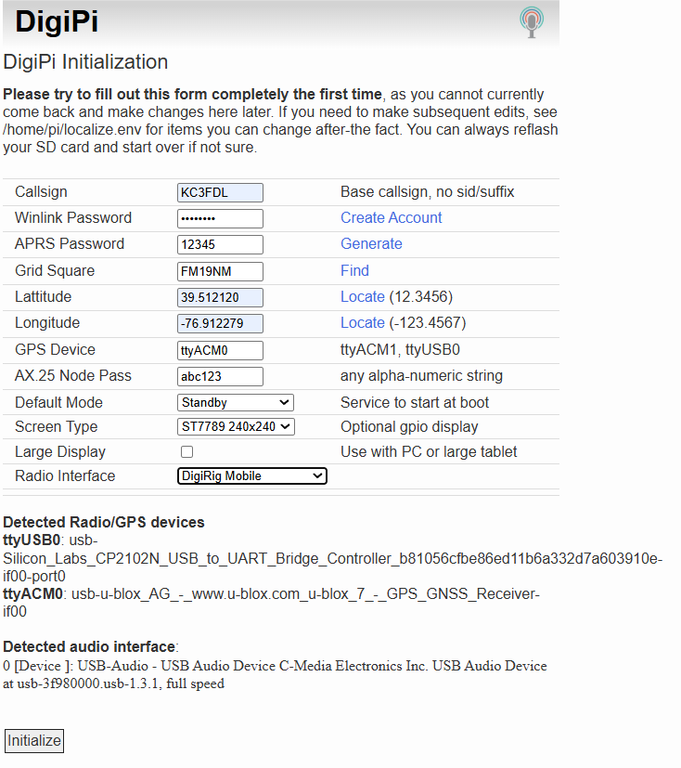
Fill in Fields.
Select: Initialize
On main screen, select “Save Configuration”
Then select “Restart”

Slide 31
Setup Process
Assemble Hardware
Image SD Card
Set up Wifi - Reboot
Initial Configuration - Save Configuration / Reboot
Make File System Read / Write (RW) - Reboot
Set Time / TimeZone
Expand File System - Reboot
Configure Radios - Save Configuration

Slide 32
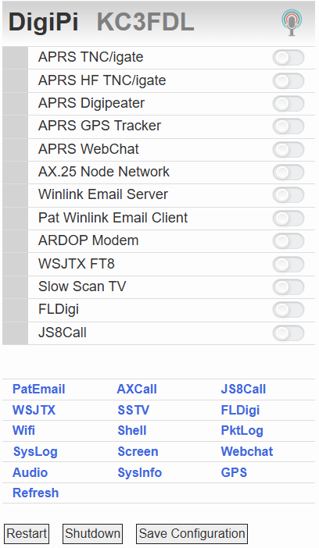
Select: Shell

Slide 33
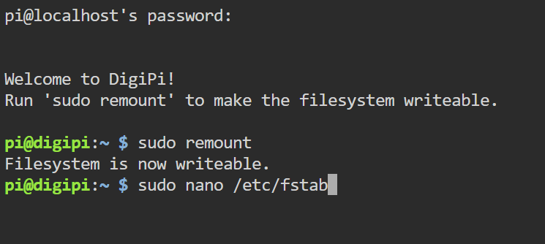
Password is: raspberry

Slide 34
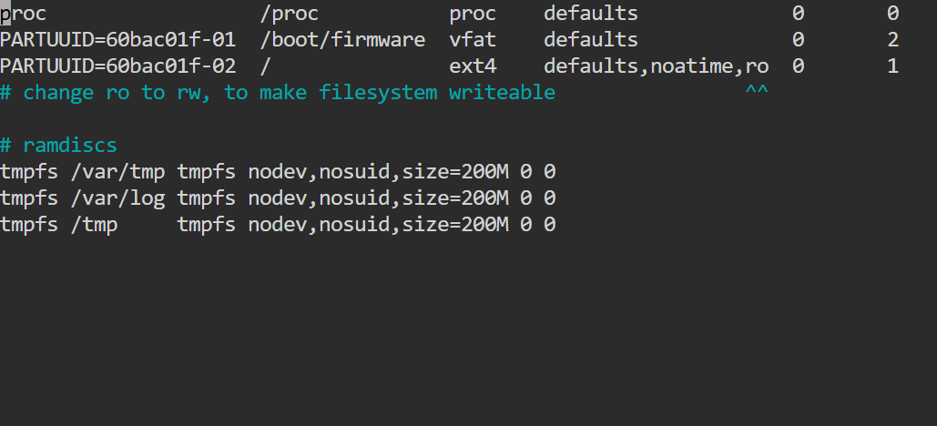

Slide 35
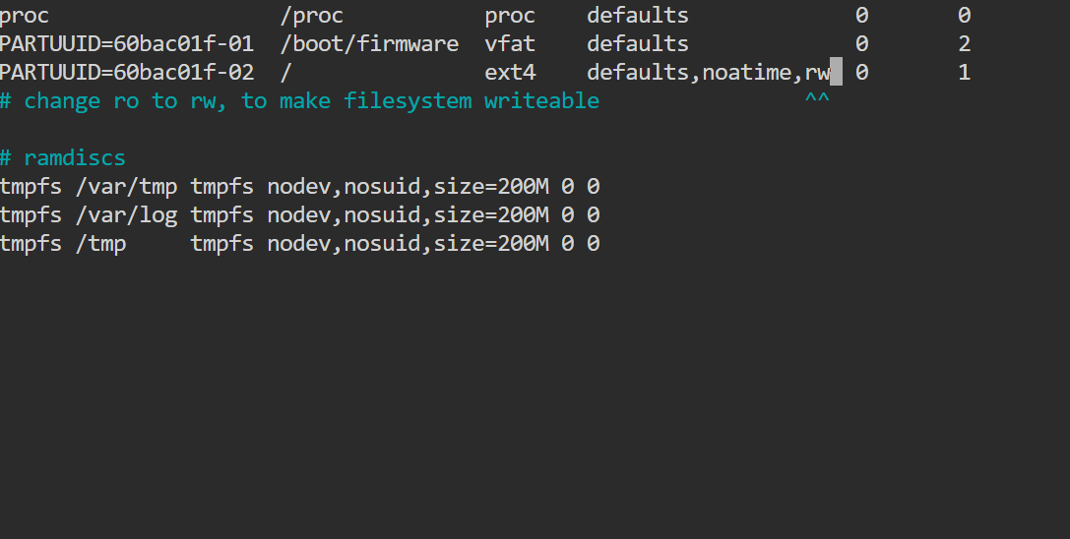


Slide 36
Setup Process
Assemble Hardware
Image SD Card
Set up Wifi - Reboot
Initial Configuration - Save Configuration / Reboot
Make File System Read / Write (RW) - Reboot
Set Time / TimeZone
Expand File System - Reboot
Configure Radios - Save Configuration

Slide 37

On main screen, select “Shell”, then login with password “raspberry”.

Slide 38
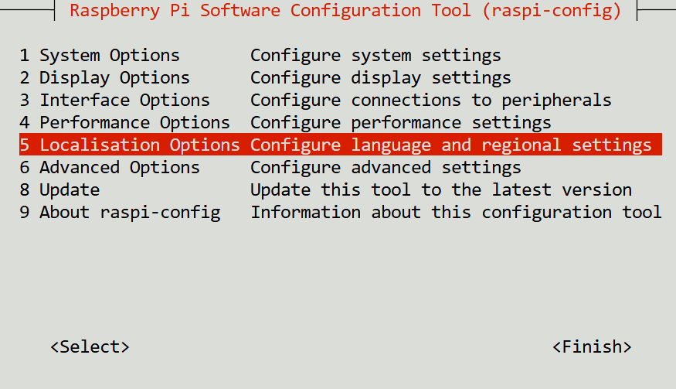

Slide 39
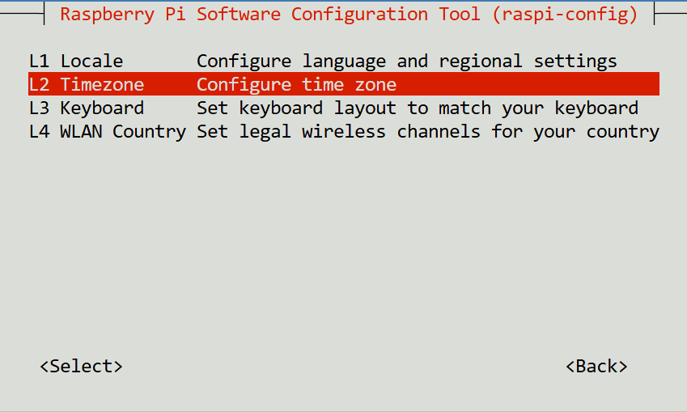

Slide 40
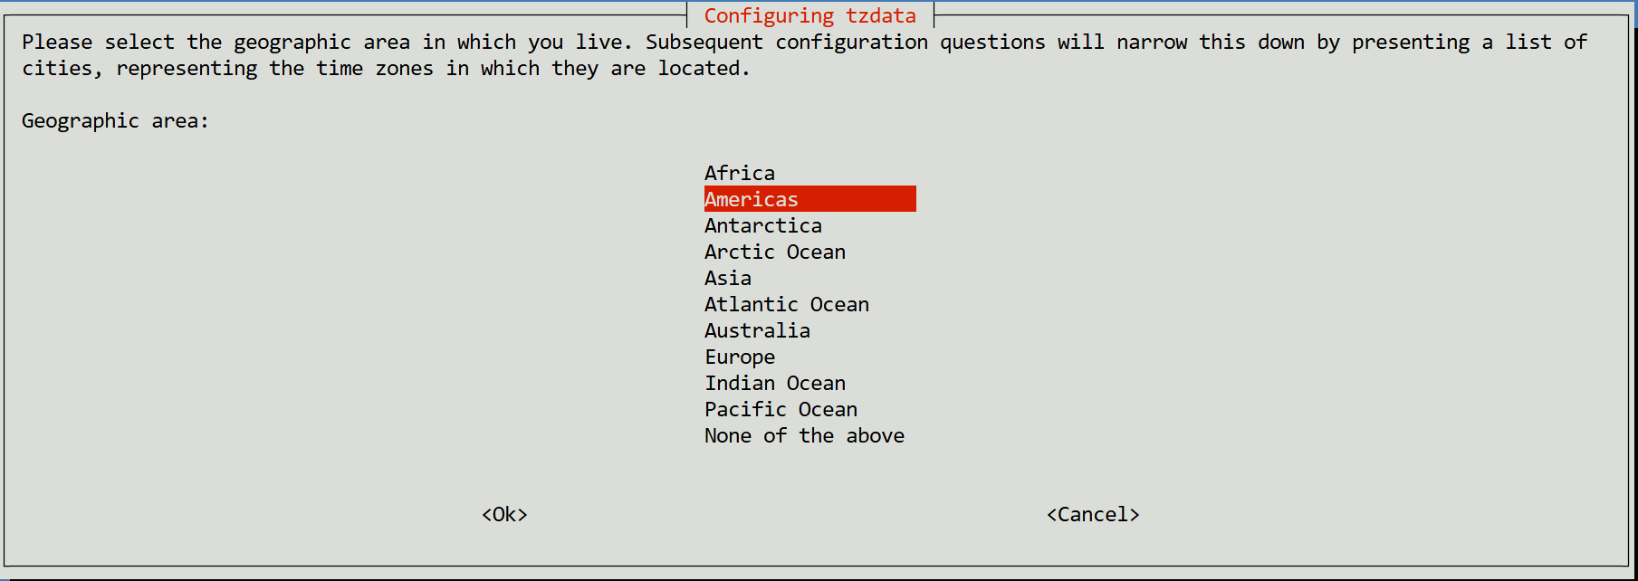

Slide 41
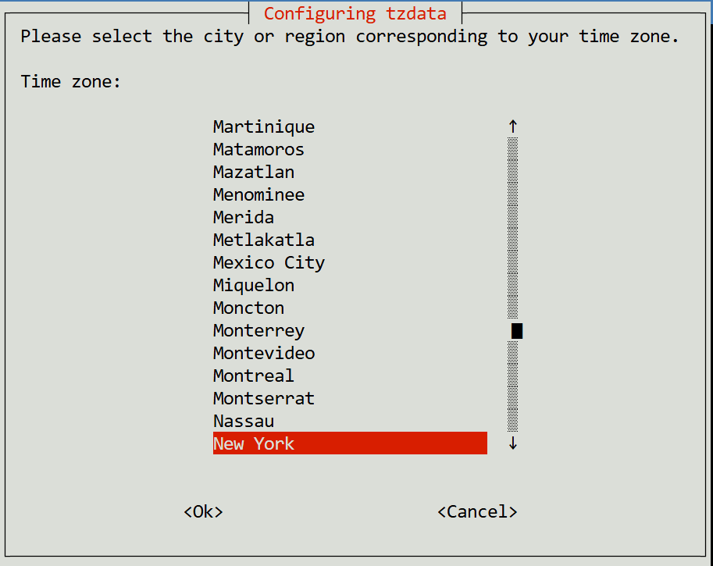

Slide 42
Setup Process
Assemble Hardware
Image SD Card
Set up Wifi - Reboot
Initial Configuration - Save Configuration / Reboot
Make File System Read / Write (RW) - Reboot
Set Time / TimeZone
Expand File System - Reboot
Configure Radios - Save Configuration

Slide 43
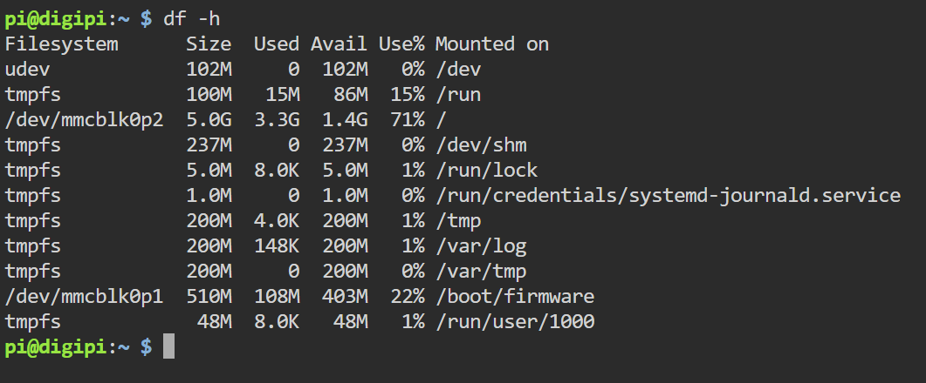

Slide 44
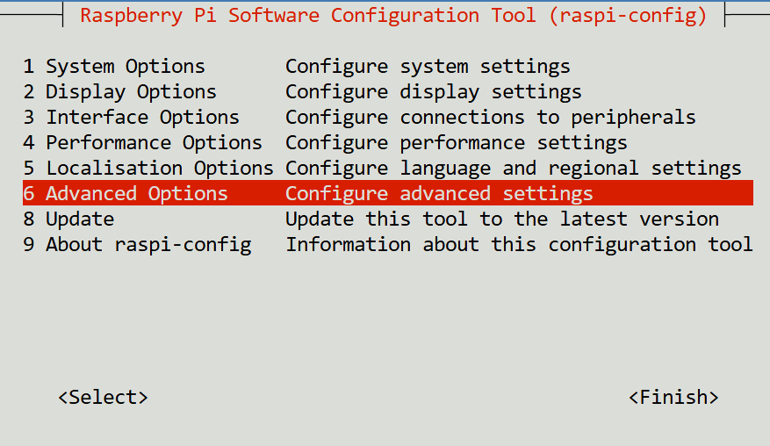

Slide 45
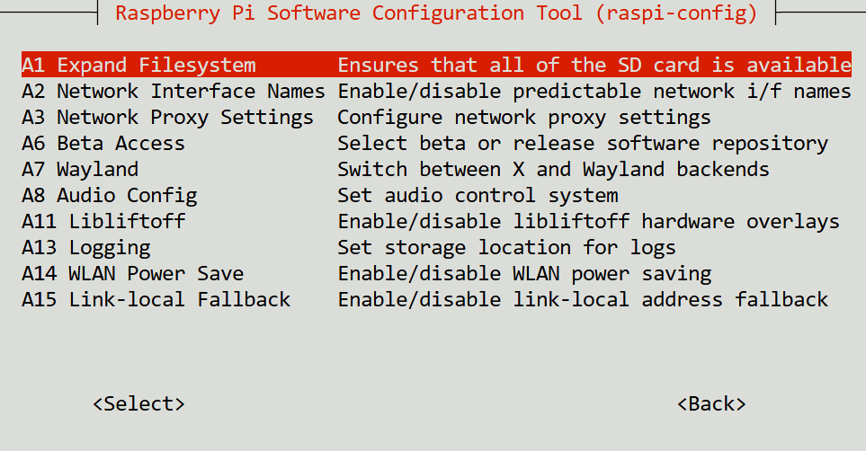

Slide 46
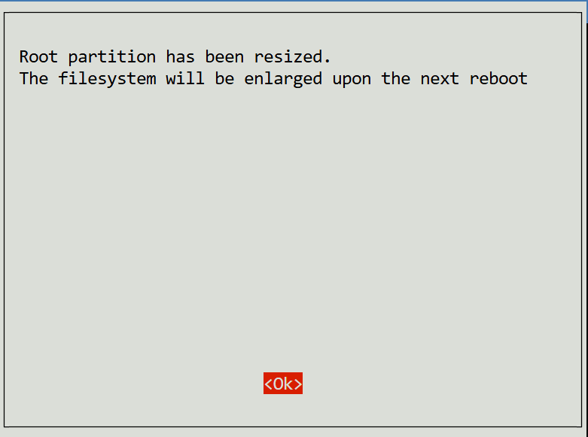

Slide 47
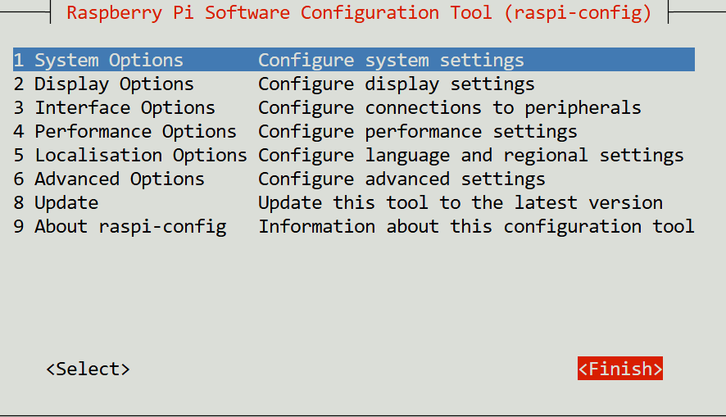

Slide 48
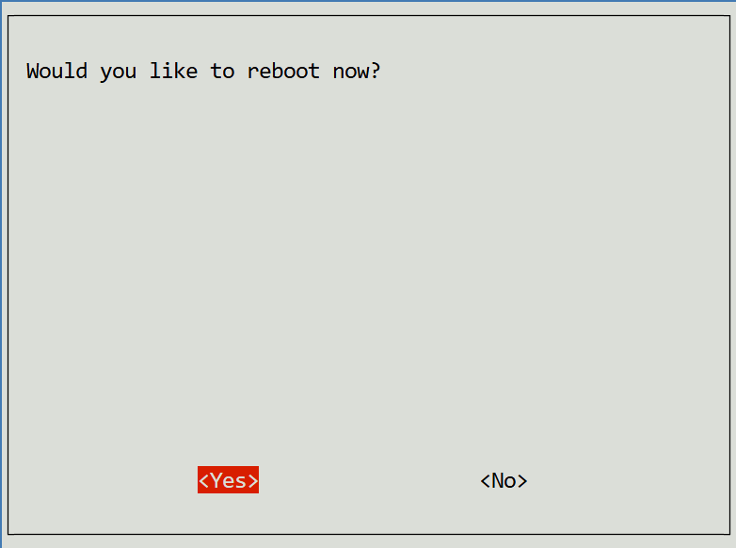

Slide 49
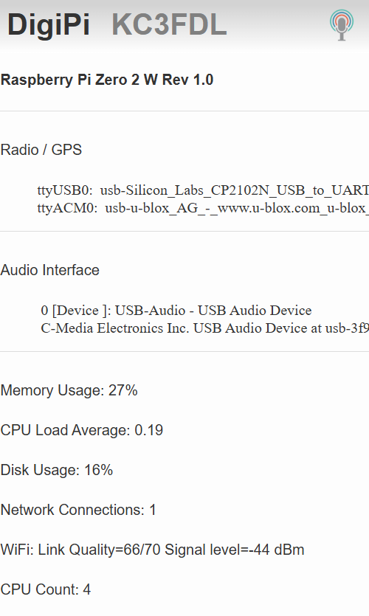
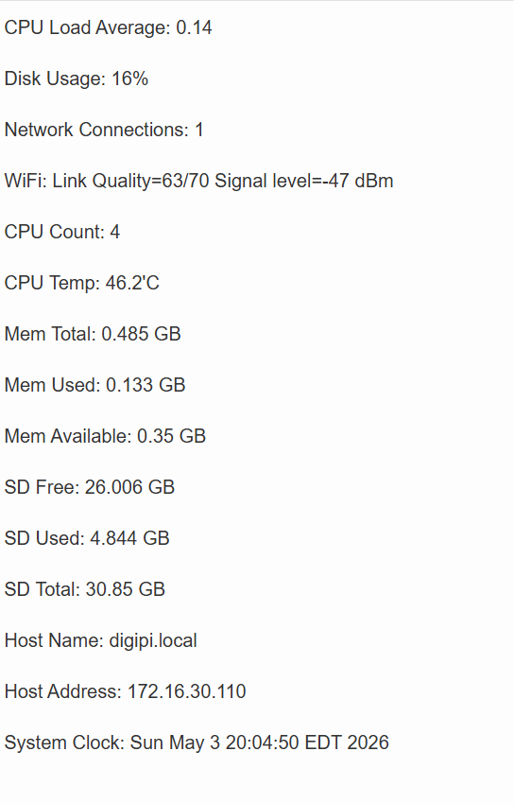

Slide 50
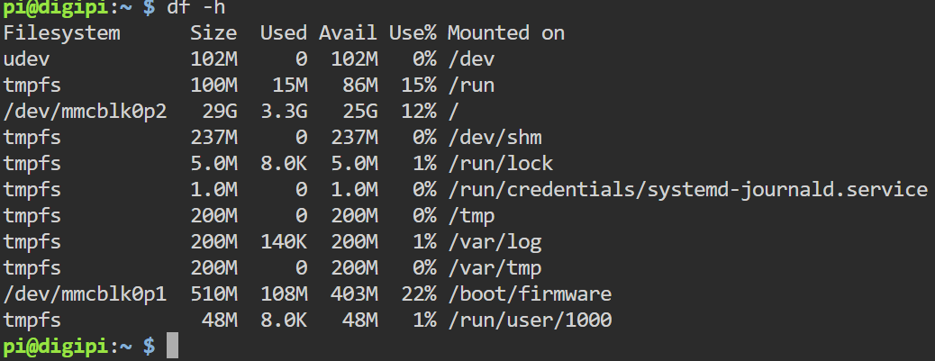

Slide 51
Setup Process
Assemble Hardware
Image SD Card
Set up Wifi - Reboot
Initial Configuration - Save Configuration / Reboot
Make File System Read / Write (RW) - Reboot
Set Time / TimeZone
Expand File System - Reboot
Configure Radios - Save Configuration

Slide 52
Configure Radios / Save Config Files
Open each of the applications.
App configuration menu should be displayed.
Enter appropriate information.
Be sure to save the configuration if allowed.
Close the program.
Return to main screen and press “Save Configuration”.
Reboot and verify config file was saved.

Slide 53
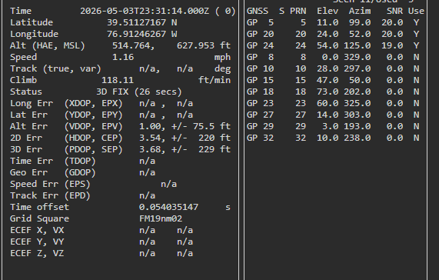
GPS Display

