Slide 1
May 8, 2023
Windows 11 Superlite (random-ish thoughts)
L-network matching

Slide 2
Toshiba Satellite circa 2007
AMD Athlon™ 64 X2 Dual-Core Processor TK-57, 1.9 GHz, 512kb L2 Cache, HyperTransport™ Technology @ up to 800MHz
3GB RAM
250GB (5400 RPM); Serial ATA hard disk drive
IO
  Video - RGB (monitor) output port
  Audio - Microphone input port & Headphone output port
  Data
    USB v2.0 – 3ports
    RJ-45 LAN port
    RJ-11 modem port
Windows 7 Pro
Notes:
Very slow and antiquated, put processor is not bad
What can I do to upgrade?

Slide 3
Upgrades
Increased memory to 4 GB $13
Swapped hard disk
  ¼ access time, same spin speed
  2X capacity
Windows 11
  Ghost Spectra SuperLite + Defender
  No bloatware or drivers
  https://www.partitionwizard.com/partitionmagic/ghost-spectre-win11-superlite-iso-download.html
Notes:
The computer’s maximum memory is 4 GB and I had a number of Serial ATA drives in my junk bin. I looked up the drive specs and picked the best one. Both these changes – disk drive primarily – yielded a significant speed improvement.
I decided to try one of the lightweight windows 11 versions. My brief research implied it should work fine on this reduced machine.

Slide 4
GhostSpectra SuperLite
Removed
  OneDrive
  Telemetry
  WinSxS backup
  Winre
  Action Center
  Print Spooler
  Windows apps and system apps
  Remote Desktop/Focus Assist/NFC/Clipboard/tablet keyboard
  Windows smart screen/Windows Defender/Windows Security (in some versions of Superlite)

Slide 5
Ghost Spectra SuperLite
Has
  It allows you to pause the Windows Update until 2077.
  It supports all different keyboards and languages.
  It has some unique theme packs, icons, and wallpaper.
  It includes the LZX algorithm.
  You are allowed to add or remove the Windows Store via Ghost Toolbox.
  It can optimize the privacy of your computer together with the performance mode.
  It enables you to run UWP games or apps.
  It helps you get the optimized page file, search indexer, and services in addition to scheduling them.

Slide 6
Installation
Make install media
  Used CD; remember it must be bootable!
  Copy extracted .ISO to it
In boot menu, set to boot from CD
Follow directions
  Fairly rapid install
  I formatted/repartitioned the disk as part of the install process
  Connect to internet
Notes:
Directions on-line are for USB boot media but I did not have a free one. You need 3 GB and I had a 4.7 GB CD

Slide 7
Drivers
Windows Update
  Installed a number of hardware drivers
  Installed bloatware – Ach!
  Bloatware can be uninstalled easily
  So, Update is now turned off
Screen Resolution
  Native is 1280 x 800
  W/O driver, defaults to 1024 x 768
  Driver install was problematic, but successful
Notes:
Default screen poor. Needed ATI Radeon 1250 driver
Standard driver installations did not work and Windows Device Manager did not recognize the ATI hardware. Claimed it was a generic PNP monitor. I had to find a Windows Vista version of the driver and manually install it.

Slide 8
Bench Laptop
Flidigi
PCR-1000 control software
WSJT software
Picoscope software
Currently listing to secret loop antenna on 630 m, decoding WSPR traffic.
Notes:
I currently have it sitting on the bench connected to a PCR-1000 communications receiver decoding WSPR traffic on 630 m. I had to use an audio USB dongle since I’ve not yet solved the problem of having it detect when the mic is plugged in.

Slide 9
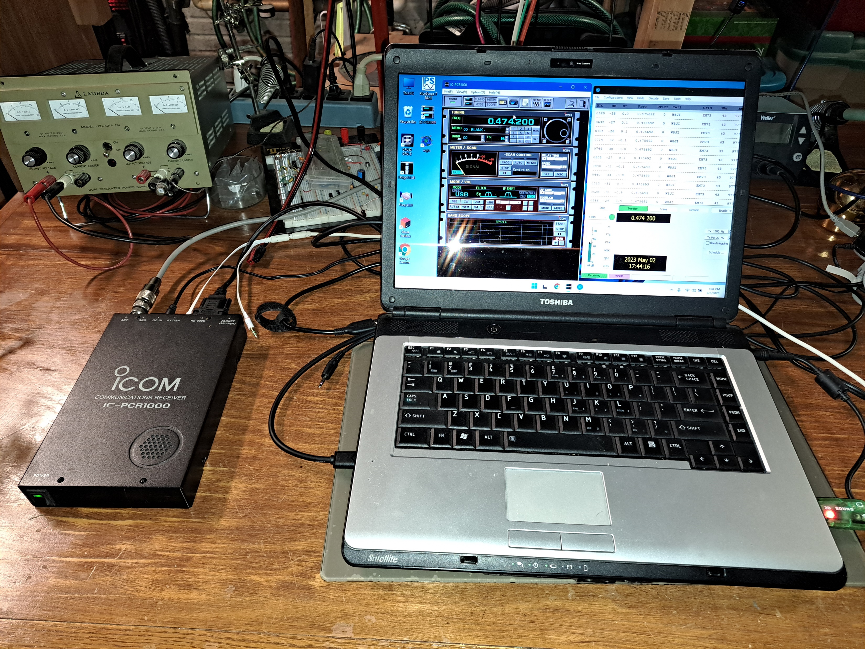

Slide 10
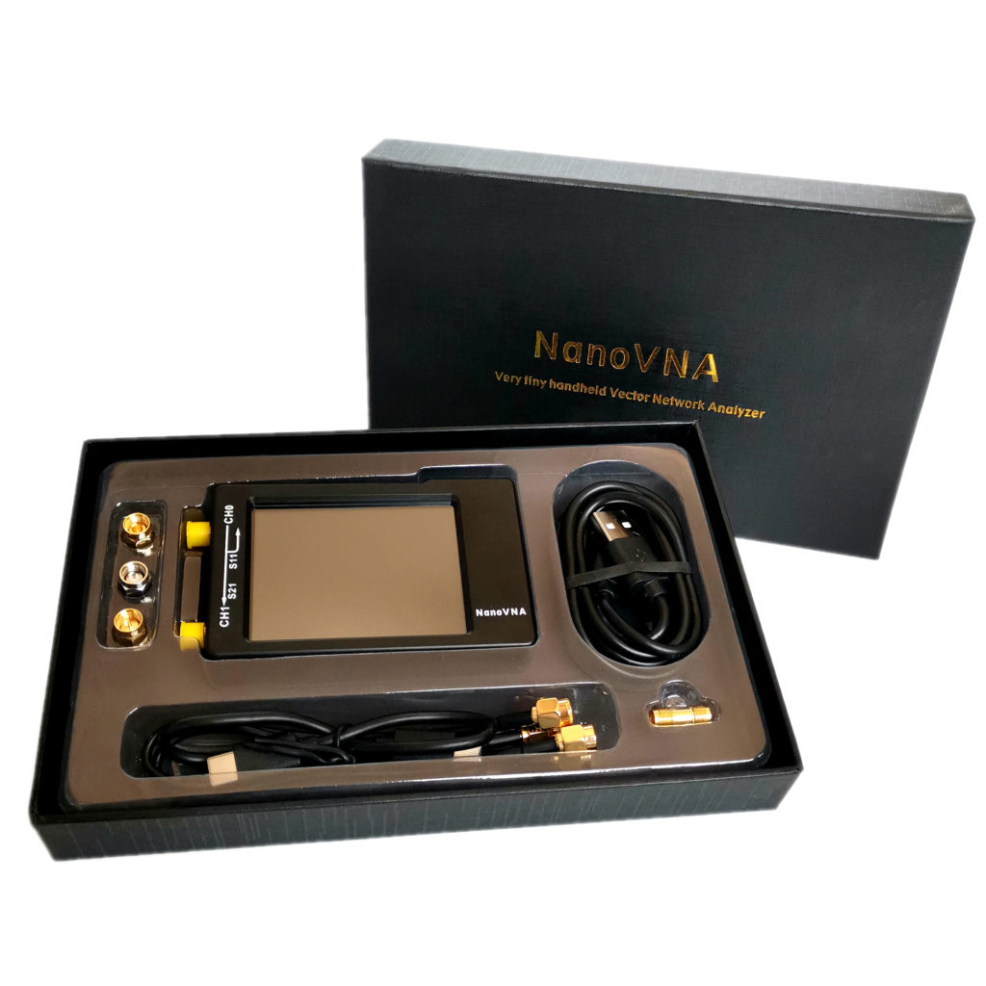
L – Matching
NanoVNA can measure component values
L matches
  Two passive components
  Single frequency
  Alternative to transformers or active circuits
Notes:
FYI, you can match with resistors but unless you are building an attenuator, no one does it.

Slide 11
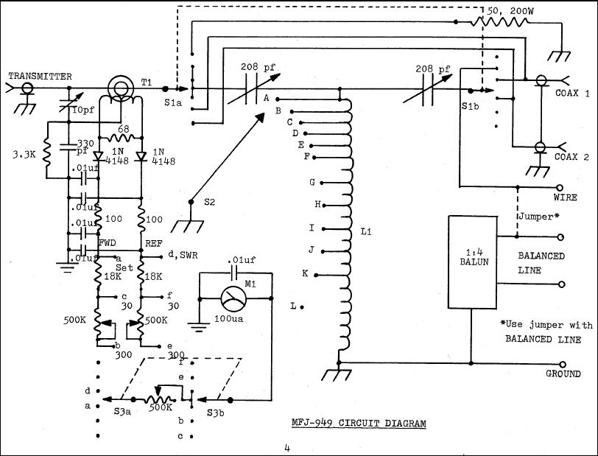
MFJ 949

Slide 12
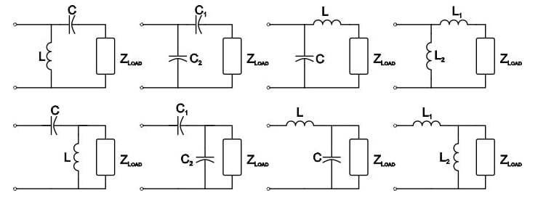
L-Matching Networks
Notes:
As you can immediately see, the different topologies will have different characteristics. Low pass and high pass, and DC short or DC block.
To use these you want to work with the resistive component, not the SWR generating impedance. For example, if you want to match 75 Ohm to 50 Ohm, at one frequency, you are good. If the impedance is 75 + j40 – a dipole – you will want to pick the topology that lets you cancel the reactance.
Note that a hairpin match is a variation on the L network where the antenna’s reactance is used as the first element. This is why in the ARRL antenna book they put constraints on what it will match. However, since we can make a section of transmission line look either capacitive (open) or inductive (short), with a little arithmetic you have more freedom.

Slide 13
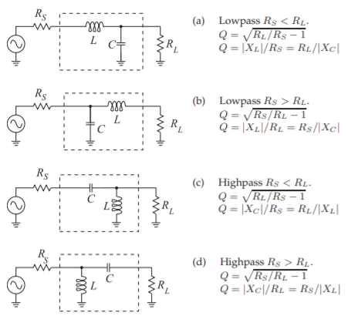
https://eng.libretexts.org/Bookshelves/Electrical_Engineering/Electronics/Microwave_and_RF_Design_III_-_Networks_(Steer)/06%3A_Chapter_6/6.4%3A_The_L_Matching_Network
Notes:
You pick the topology based on what you want to match. Recall that a hairpin match which is a small, shorted transmission line acting as an inductor, is topology C, hence the requirement for Rs to be less than Rl.
You can, however, change the length of the line and whether it is open or closed to get different values of either inductance or capacitance.

Slide 14
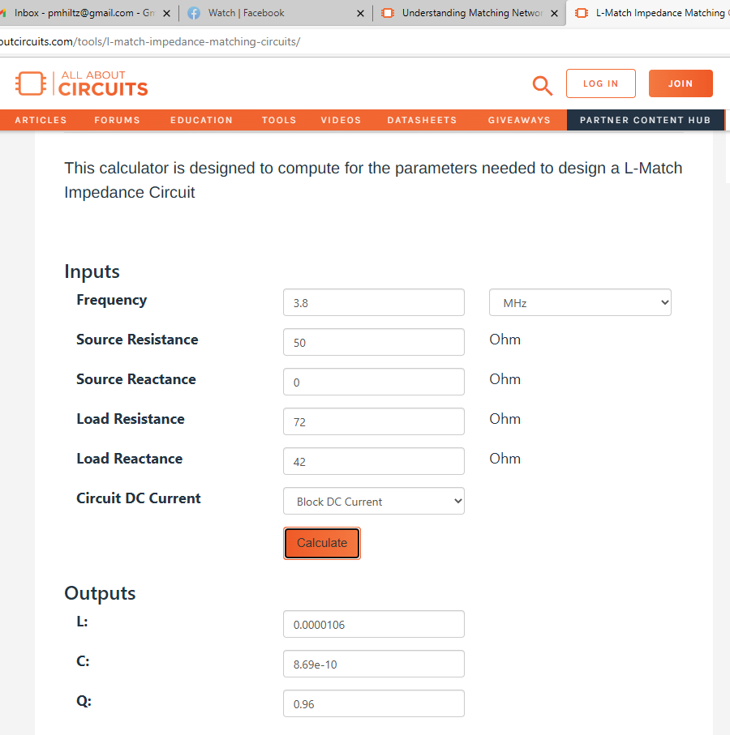
From https://www.allaboutcircuits.com/tools/l-match-impedance-matching-circuits/
Ideal dipole 72 + J40 Ohm
Ideal cable 50 Ohm
L = 0.0000106 H
  10 uH
C = 8.69 e-10 F
  700 pF
Notes:
Here is where I use the nanoVNA. The capacitor might be an easy buy, but the inductor (for power) might not. You may want to wind your own, and use the nanoVNA to verify or adjust it.
Let’s do another.

Slide 15

From https://www.allaboutcircuits.com/tools/l-match-impedance-matching-circuits/
Antenna 2000 +jJ450 Ohm
Cable 75 Ohm
L = 0.0001 H
  100 uH
C = 8.69e-10 F
  700 pF
Notes:
This would match my secret 630 m antenna!

Slide 16
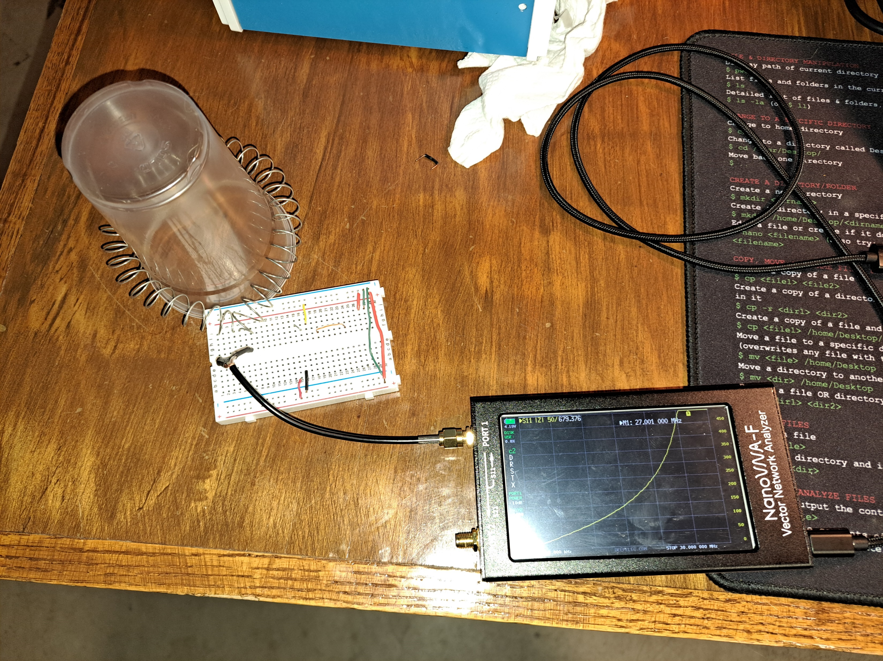

Slide 17
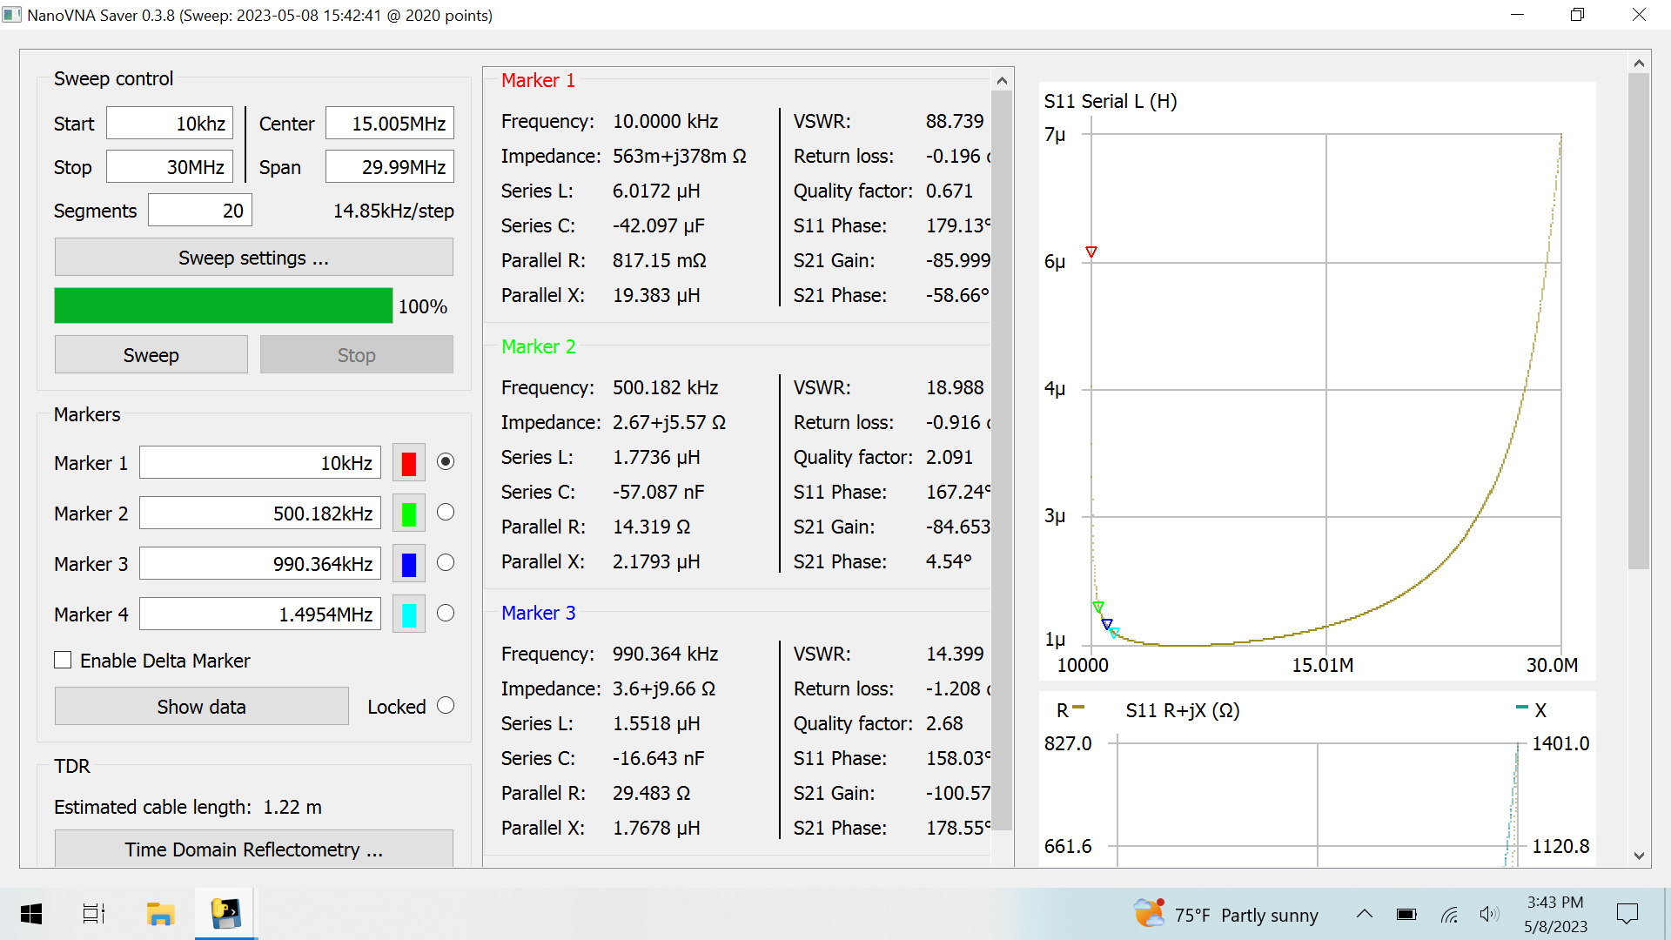

Slide 18
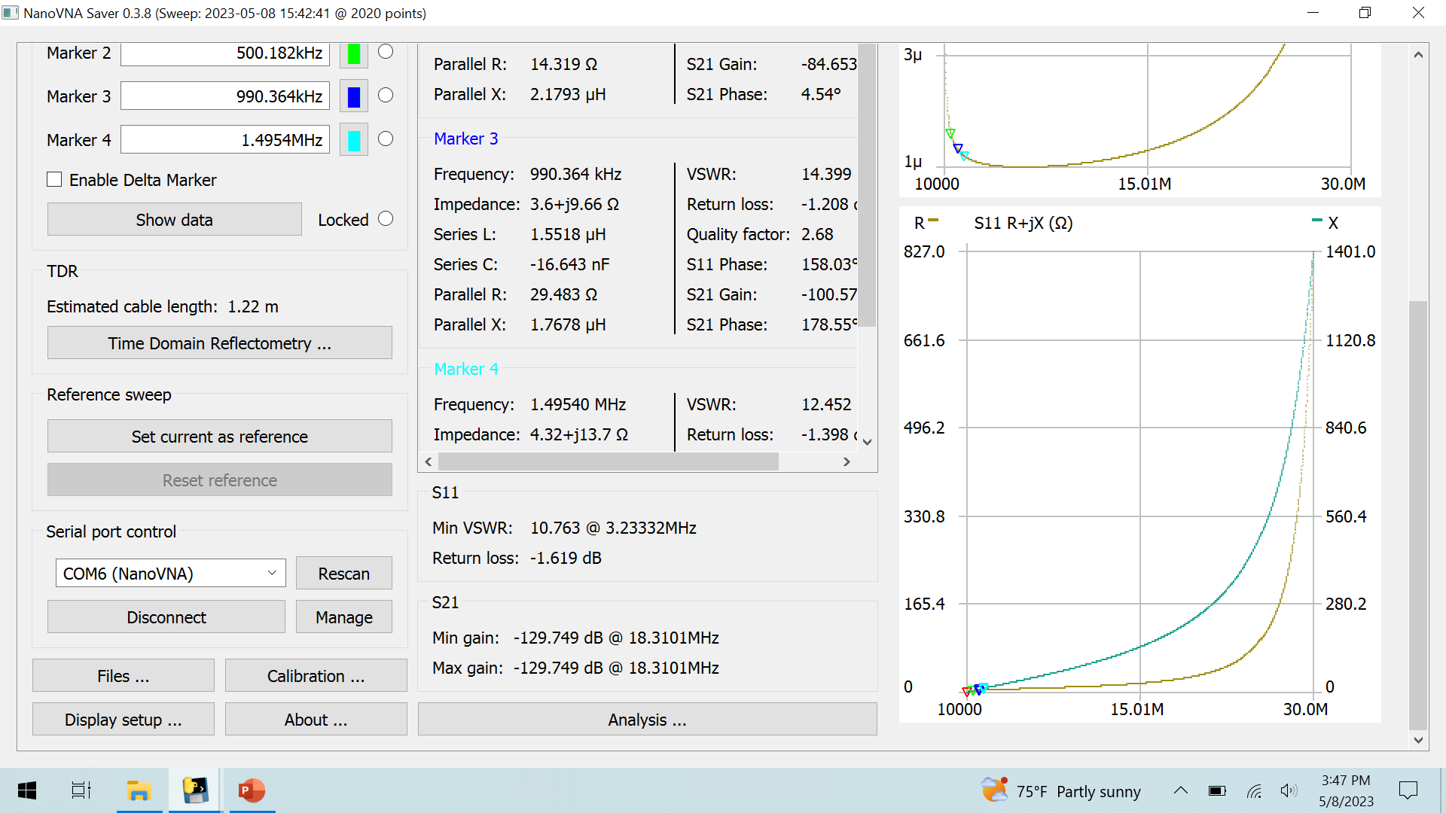

Slide 19
Online Sources
https://www.allaboutcircuits.com/tools/l-match-impedance-matching-circuits/
https://eng.libretexts.org/Bookshelves/Electrical_Engineering/Electronics/Microwave_and_RF_Design_III_-_Networks_(Steer)/06%3A_Chapter_6/6.4%3A_The_L_Matching_Network

