Slide 1

Linux and Raspberry Pi
An introduction in two parts

Slide 2
Thanks to
Dave, KC3MKC
John, KC3FDL
Nick, WT3O
Matt, W3MDW
Brent, KC3RUO
Pete, WV3S

Slide 3
Acknowledgements
Many sources are used and cited throughout the slides.
We make no claim to any material. Any omission of citation is purely accidental.
Any and all copyrights for any used material are held by the originators.
This instantiation of material is copyright Carroll County Amateur Radio Club, Inc., except where other copyrights exist.
Any and all copyrights for any used material are held by the originators.
This instantiation of material is copyright Carroll County Amateur Radio Club, Inc., except where other copyrights exist.

Slide 4
Agenda
Introduction to Raspberry Pi
Introduce the basics of Raspberry Pi so you can load an operating system and understand the inputs and outputs.
Introduction to Linux
Introduce the basics of Linux including file structure, basic command line operations, and how to load software

Slide 5
Raspberry Pi Versions
Raspberry Pi A / A+ / B / B+
Raspberry Pi 2 B Around $30
Raspberry Pi 3 A+ / B / B+ Around $30 to $50
Raspberry Pi 4 B Around $30 - $75
Raspberry Pi Zero Around $5
Raspberry Pi Zero W Around $10 (adafruit)

Slide 6
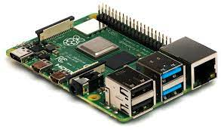
Pi 4 Specs
WIFI - Dual band wireless
Bluetooth, BLE
USB – 2 USB2, 2 USB3
Gigabit Ethernet
HDMI - 2x mini HDMI
Stereo output and composite video
General Purpose Input Output (GPIO)
CSI camera port
DSI touch screen port
Quad processor, ARM V8 64 Bit SOC, 4 cores
2, 4, or 8 GB on board memory

Slide 7
Bare minimum
Pi
Power Supply 5V, 2.5 A
SD Card
Monitor
Keyboard & Mouse
Monitor adaptor cable (maybe)
Notes:
For the SD card, speed matters. Also, if you plan to make an image copy note that imagers copy the whole card, not just the used space. You alway need a SD card at least as big as the physical media you copied.

Slide 8
Bare, bare minimum
Pi
Power Supply 5V, 2.5 A
SD Card
Monitor
Keyboard & Mouse
Monitor adaptor cable (maybe)
Notes:
You will have to add a file to the SD card to give network access if you don’t use a monitor. The file, wpa_supplicant.conf, is added to the SD card after you’ve written the OS image. We’ll talk about this more later.

Slide 9
From the box….
Format SD Card
  SD Card Formatter https://www.sdcard.org/downloads/formatter/
Copy OS image to it https://www.raspberrypi.com/software/
  Add wpa_supplicant.conf
Insert in SDCard in Pi, connect monitor, keyboard, mouse, power
Power on
Follow boot instructions
You’ve done it!
Notes:
We’ll go through this for you now and refer you to the Recipe sheet and the many great online resources. A google search on “raspberry pi OS” will take you to the Raspberry Pi Foundation web pages which details the steps.

Slide 10
If headless operation is desired
After installing the OS, in the Windows (or Mac) machine you used to burn the SD card
Add the file wpa_supplicant.conf containing
ctrl_interface=DIR=/var/run/wpa_supplicant GROUP=netdev
country=US
update_config=1
network={
ssid="network_name"
psk="passwordf"
}
Insert SD card and let boot
Locate Pi on your network then realVNC into it.

Slide 11
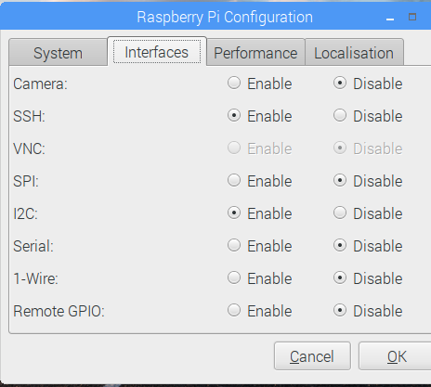
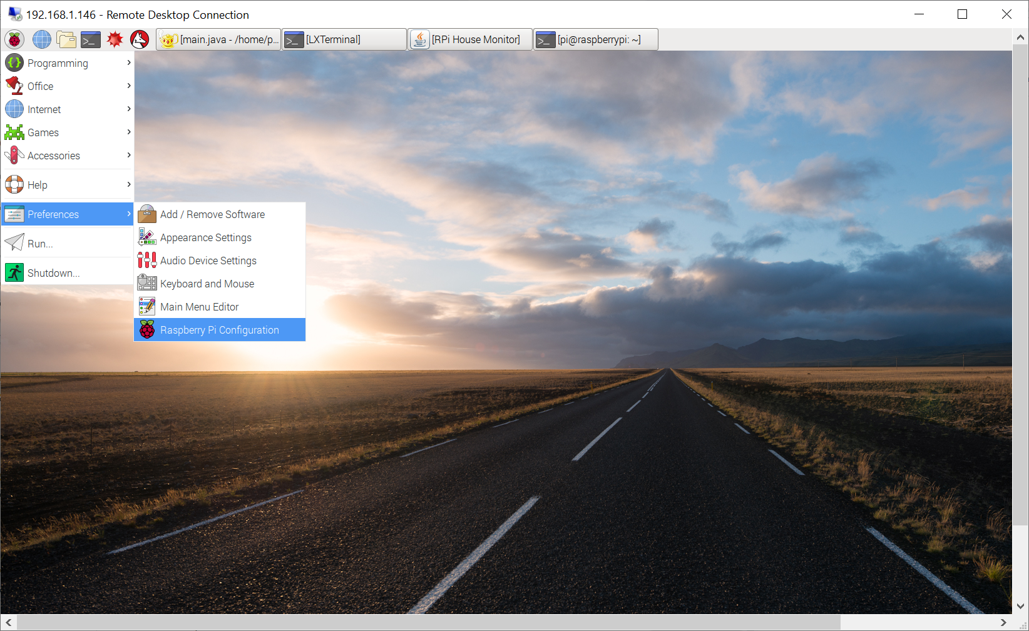

Slide 12
Interfaces
Wifi, Ethernet
Bluetooth, Bluetooth BLE
USB
GPIO
SPI
I2C

Slide 13
Wifi, ethernet, Bluetooth, USB
2.4 GHz and 5.0 GHz 802.11 AC wireless
Gigabit ethernet
Bluetooth 5.0 & BLE
USB 2.0 (2x) USB 3.0 (2x)

Slide 14

GPIO
Pin mappings are the same on all Pi!
3.3V Max
16 mA Max
We’ll next get a bit technical so you’ve heard the terms.

Slide 15
GPIO Numbering
Two different numbering schemes in use
Broadcom pin numbering
Pin number
WiringPi libraries are included with the current OS but can be installed.
Know which you are using, that is, what physical pin is what Broadcom pin.
In terminal window, run command “gpio readall” if wiringPi is installed
In Python,
import RPi.GPIO as GPIO
GPIO.setmode(GPIO.BCM)GPIO.output(18,GPIO.HIGH)

Slide 16
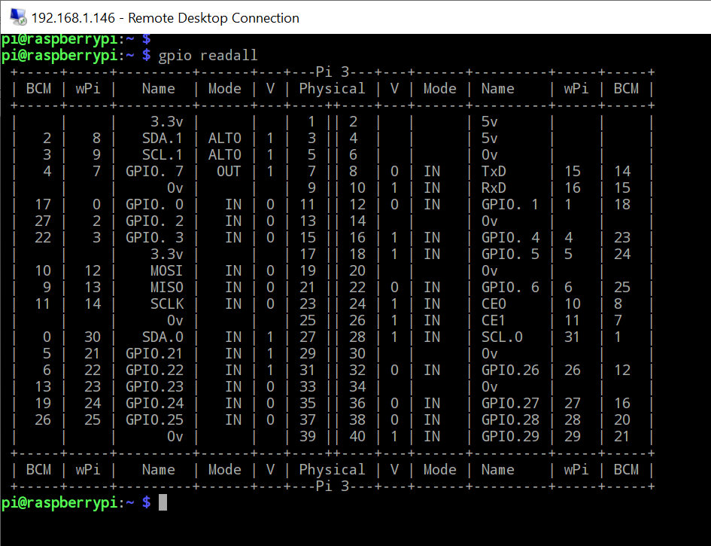
gpio readall

Slide 17
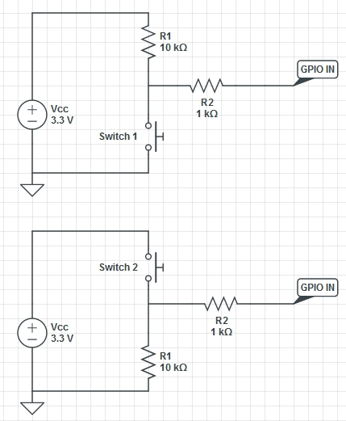
GPIO
Configurable as
Pull-up
Pull-down
https://www.cl.cam.ac.uk/projects/raspberrypi/tutorials/robot/images/EGHS-PullUpDownSwitchProtected.jpg
Notes:
Talk about this here. Describe it, or redraw on whiteboard. Explain why you need it.

Slide 18
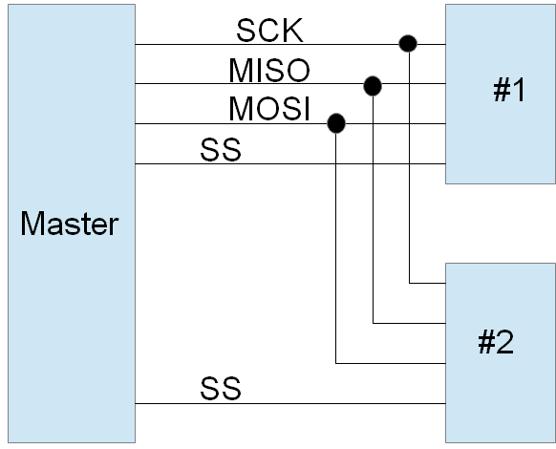
Serial Peripheral Interface (SPI)
Each device selected by its own select line
Higher data transfer than I2C, but more wires
GPIO9 = MISO
GPIO10 = MOSI
GPIO11 = SCK
GPIO8 = CE0 (SS0)
GPIO7 = CE1 (SS1)

Slide 19
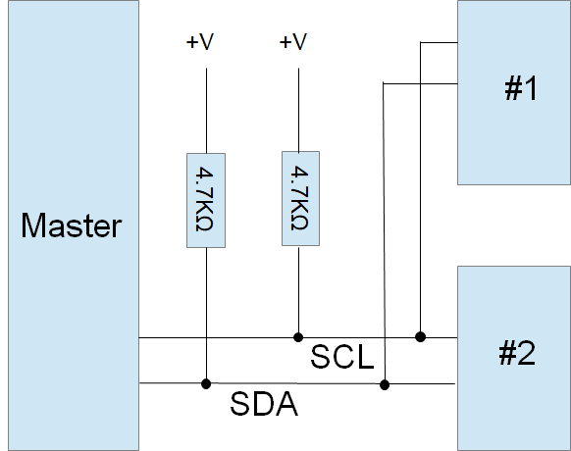
Inter-Integrated Circuit (I2C)
Each device has a unique address
Distance limited but can get extenders.
Many sensors and displays hae I2C interface
Libraries exist!
GPIO2 is SDA
GPIO3 is SCL

Slide 20
Operating Systems/Distros
Raspberry PI OS - OEM OS, 32 bit. 64 just deployed.
Libra Elec - Kodi Entertainment Center
Ubuntu Desktop or Server - Popular desktop Operating System
MotioneyeOS - Security camera OS
HamPi - OS focused on Ham Radio Applications
OpenMediaVault - Installs on top of Raspbian, network attached storage
Home Assistant - Central control system for smart home devices
Notes:
Note that Raspberry PI OS is typical.

Slide 21
Operating Systems
RetroPie (retro gaming)
OctoPrint (3D printing)
PiDora (Fedora on Pi)

Slide 22
Hats
Radioberry SDR Transceiver
WSPR
Sense Hat
Google Voice Hat
IO Expander
Audio
Fan
Relay

Slide 23

Introduction to Linux
In 1991, Finnish student Linus Torvalds wanted to create an alternative OS for desktop computers that was free and modifiable by anyone. This is known as ‘open source’ software because the source code is open to the public (as opposed to ‘closed source’ software like Windows where the source code is not open to the public). Linus created the UNIX-like OS and called it “Linux” (Linus + UNIX = Linux).
Tux

Slide 24
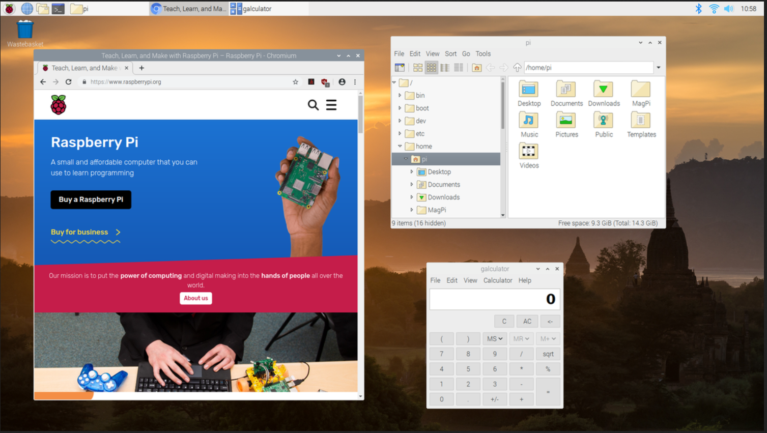
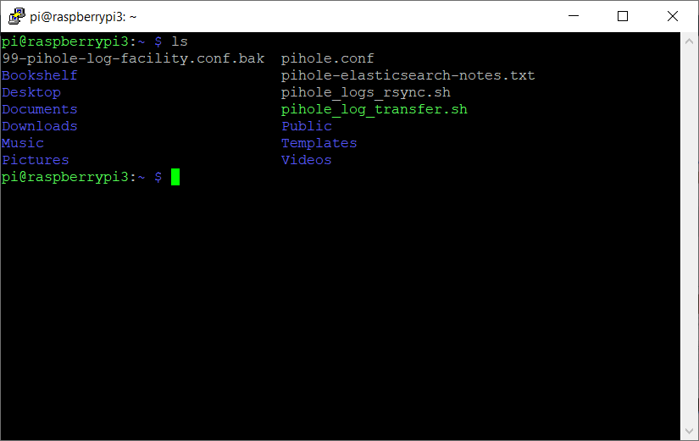
Different ways to use Linux
Graphical User Interface (GUI)
  Similar to Microsoft Windows
  Very easy to use
  Web browsers, word processors, clipboard, drag & drop, etc
  Very customizable
    Desktop Environments (Gnome, KDE)
  Not all features implemented in GUI
  Use locally or over a network using VNC/Remote Desktop
Text-based User Interface (TUI)
  Similar to Windows Command Line Interface
  A bit more complex to use
  Very powerful commands/tools
  Command outputs can be fed into other command inputs
  Ability to script/automate actions
  Use locally or over a network using SSH

Slide 25
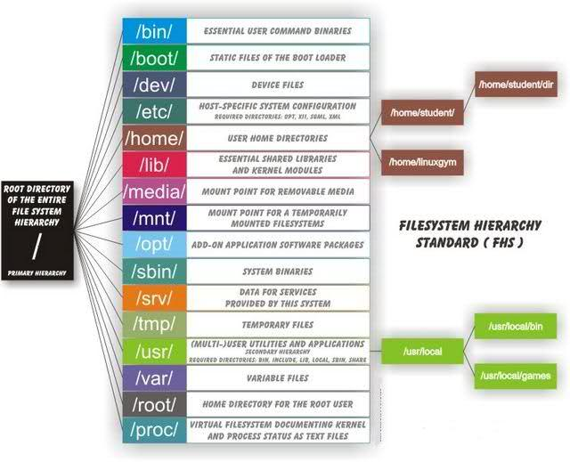
File Structure
File structure is top down
/ - root directory, all other directories are under this directory
/bin & /sbin - essential binary files (programs), /sbin is generally for root user
/etc - configuration files
/home - user home directories
/usr - user binary files and read only data
/var - writable data files, most log files are found in /var/log/
https://www.tecmint.com/linux-directory-structure-and-important-files-paths-explained/
Notes:
Important to note that there are two definitions to the term ‘root’. The first being the ‘root directory’ or ‘/’ which is the first level of the file system hierarchy.
The second definition of ‘root’ is the user. The ‘root user’ serves as the user with unlimited power and access. Use of the ‘root user’ should only be used for system maintenance (add/removing programs, modifying system config files, etc.) and should NEVER be used as your day to day login.
The user ‘root’ has special directory ‘/root’ that contains all of its important files.
Similarly, each individual user has their own directory to store their files. Regular users’ directories are under the ‘/home’ directory. For example, the default user ‘pi’ (supplied by RaspianOS) has a home directory at ‘/home/pi’. Under this directory you should find additional directories such as “Documents”, “Downloads”, “Desktop”, “Music”, and “Videos”.

Slide 26
File Structure
/bin : The base command line utilities provided with the OS that are not used by the root user(admin) typically reside here.
/boot : Holds important files used by the boot-up process, including Linux Kernel.
/dev : Contains device files for all the hardware devices on the machine e.g., cdrom, cpu, etc
/etc : Contains Application’s configuration files, startup, shutdown, start, stop script for every individual program.
/home : The default home directory of regular users, your account will be here. If you created an account called bob the full path will be /home/bob. The bob account directory will contain other directories like Desktop, Downloads, Documents, etc.
https://www.tecmint.com/linux-directory-structure-and-important-files-paths-explained/
Notes:
Let’s go through this and mention some of the important directories and files. This will not be exhaustive but it will be exhausting, but it is good to hear this at least once. This information is easily found on-line if you want to review or need to better understand the Linux file structure.
INSTRUCTOR NOTE: Try to not simply read this off the screen but paraphrase what each directory does.
Of these directories, only ‘/etc’ and ‘/home’ will be used on a regular basis, with ‘/home’ being the most prevalent. As mentioned earlier, ‘/home’ contains sub-directories with one for each user defined to the system.
The ‘/etc’ directory and sub-directories are for system configuration and specific program configuration. Files in these directories should only be modified for specific reasons and as directed. Failure to properly configure these files may result in an unbootable system!

Slide 27
File Structure
/lib : The Lib directory contains kernel modules and shared library images required to boot the system and run commands in root file system.
/media : Temporary mount directory is created for removable devices such as a usb memory stick or usb dvd drive.
/mnt : Temporary mount directory for mounting file system.
/opt : 3rd party programs that aren’t included with the OS typically go here. The intent is any applications here are typically available to all users on a linux system.
/proc : All running programs get a PID (Process Identification Number) assigned to it. PIDs are tracked here.
Notes:
When you insert a USB memory stick or drive, the OS will generally automatically ‘mount’ the device and attach the devices file system to its own. It will create a temporary directory in ‘/media’ and connect the two file systems.
For example, if you have a USB flash drive with a directory /mystuff, when you insert the USB flash drive the OS will create a temporary directory under /media and make a connection. Therefore you end up with something similar to ‘/media/USBDrive/mystuff’. You can access anything on the flash drive, read from, write to, delete. It acts like part of the system’s file system (because it is!). When you are finished, you MUST ‘umount’ (unmount) or ‘eject’ the flash drive. This will allow the OS to complete the writing to the device and detach it from the file system. If you look in the ‘/media’ directory again, you will see the USBDrive directory is gone.
‘/mnt’ is generally used for network attached storage devices.

Slide 28
File Structure
/root : This is the home directory of root(admin) user and should never be confused with ‘/‘
/sbin : Contains programs used by the root(admin) account. Commands here often but not always require root(admin) privileges.
/srv : Service is abbreviated as ‘srv‘. This directory contains server specific and service related files.
/sys : Modern Linux distributions include a /sys directory as a virtual filesystem, which stores and allows modification of the devices connected to the system.
/tmp :System’s Temporary Directory, Accessible by users and root. Stores temporary files for user and system, till next boot.
Notes:
Unless specifically instructed to do so, there is no reason to be modifying anything in these directories.

Slide 29
File Structure
/usr : Contains executable OS provided binaries, documentation, source code, libraries.
/var : Data that constantly changes state goes here. You typically will find log files and databases here.
Notes:
Again, unless specifically instructed to do so, there is no reason to be modifying anything in these directories.

Slide 30
Important Files & Directories
/boot/vmlinuz : The Linux Kernel file.
/dev/sda : This is typically the first hard drive you have connected. This can be a drive with spinning platter, a solid state disk, a sd-card or even a usb stick.
/dev/sdb,sdc, etc : Typically a second hard drive or external storage such as a usb stick or dvd drive.
/dev/null : Think of this device as a black hole. Any information you send here is immediately deleted.
/etc/crontab : A shell script to run specific commands on a predefined time Interval.
Notes:
Likewise…...

Slide 31
Important Files & Directories
/etc/fstab :Tells the OS how to connect storage and where it needs to be.
/etc/hosts : Manually maps ip addresses to hostnames or web addresses.
/etc/hosts.allow : List of hosts allowed to access services on the local machine.
/etc/host.deny : List of hosts denied to access services on the local machine.
/etc/issue : Allows to edit the pre-login message.
Notes:
These files are generally created automatically during system creation or the booting process. Unless specifically instructed, leave them alone.

Slide 32
Important Files & Directories
/etc/modules.conf : Configuration files for system modules.
/etc/motd : motd stands for Message Of The Day, The Message users gets upon login at a terminal.
/etc/passwd : Contains user account information. Please note that this file does not contain passwords despite its name. The filename password is a throwback to an earlier time when this was the case.
/etc/resolv.conf : Domain Name Servers (DNS) being used by System.
/usr/bin : Normal user executable commands
Notes:
Likewise….
Note, the /etc//passwd does, in fact, contain user passwords. But before you get all excited, they are ENCRYPTED, and cannot be decrypted. Best to leave them alone so you don’t accidentally make it impossible for yourself or someone else (mostly YOU) to log in.

Slide 33
Important Files & Directories
/usr/include : Holds files called headers that are used during the compilation of programs.
/usr/share : Shared directories of man files, info files, etc.
/usr/lib : Library files which are required during program compilation.
/usr/sbin : Additional commands for the root(admin) account.
Notes:
Move along, nothing to see here…..

Slide 34
Permissions
Permission Types Read Write Execute
Permission Groups Owner Group All_users
Files or directories!
Notes:
Review what these mean and discuss the three-bit format used. You may need to explain it to those who’ve never seen it before . Then explain the chmod command.
Explain that you may have to change a file’s permissions to do something with it.
We can do three things to a file. We can read it. We can write to it (or over-write it). And we can execute it (a program for example). We need to tell the system what people are allowed to do with it. This is done using ‘permissions’. You can have ‘read’, ‘write’ and/or ‘execute’ permissions.
Additionally, we can tell the system WHO can use the file. There are again, three groups. You (the owner), members of your ‘group’ (discussed later, maybe) and everyone else.
You need to tell the system WHO can do WHAT. For example, if you write a script (a program) you may decide that YOU can read, write and execute it, your GROUP can read and execute it, and EVERYONE is prevented from reading it, writing or over-writing it and executing it.
(NOTE: I guess this is where we need to explain the rwxrwxrwx mess…... )

Slide 35
Adjusting Permissions
‘chmod 751 pete.txt’
“chmod” Change permissions
_rwxr-x--x ‘owner’ ‘group’ ‘ all_users’ 111 101 001 = 751
So 751 on file pete.txt means
The owner has read, write and execute permission (rwx)
The group has read and execute permission (r-x)
All users can execute the file (--x)
read
write
execute
Notes:
Review what these mean and discuss the three-bit format used. You may need to explain it to those who’ve never seen it before . Then explain the chmod command.
Explain that you may have to change a file’s permissions to do something with it.

Slide 36
Commands
Linux commands are case sensitive - unlike Windows/DOS
Many good online resources for basics (https://www.hostinger.com/tutorials/linux-commands )
ls - List a directory contents
cd - Change directory
shutdown (turn off (-h), reboot (-r)) - Power off/reboot computer
Notes:
These are just examples of commands.

Slide 37
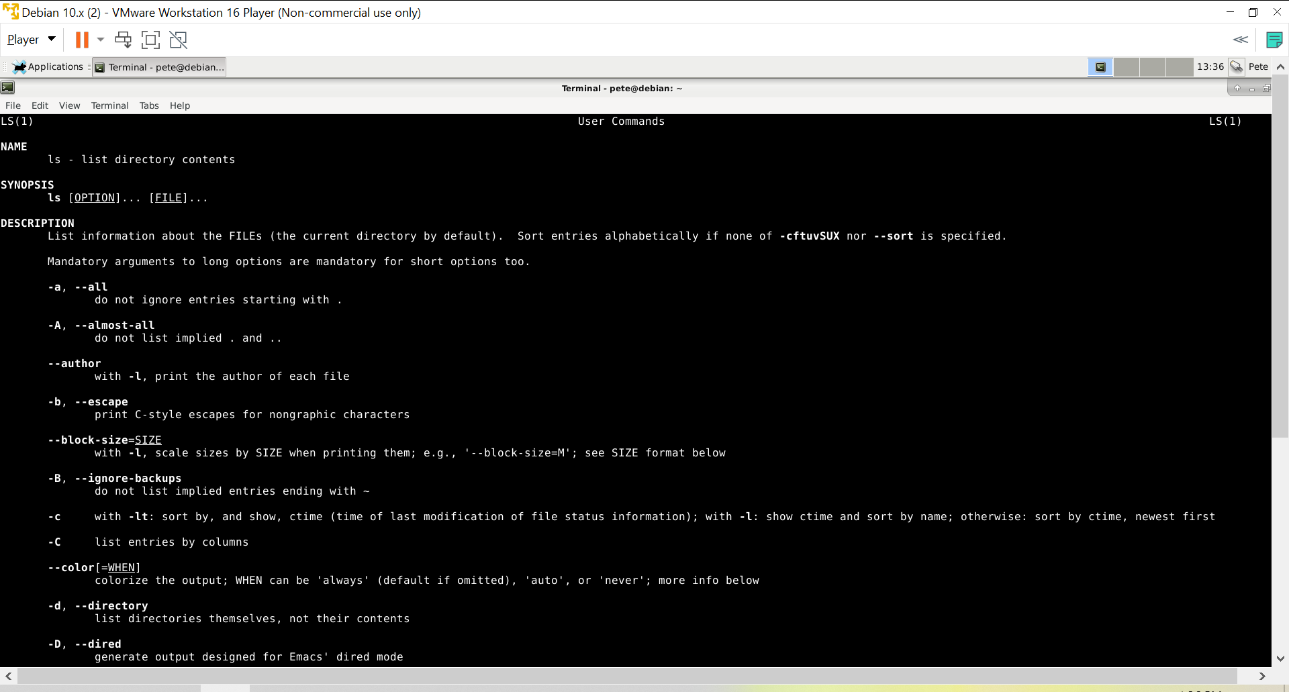
Man Pages
man ls
Man (manual) pages are the user manual pages for linux commands
Provide in-depth explanations of commands
Standard format

Slide 38
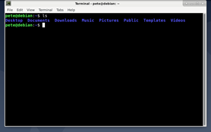
ls
Lists the files and directories in your current location (Blue files are directories)
‘ls -la’ - provides a ‘long’ listing which gives more information

Slide 39
cd : Change directory
‘cd ..’ move up one level
‘cd /’ move to the root directory
‘cd ‘ By itself moves you to your home directory
‘cd /some/path/name’
‘cd -’ move to the previous directory

Slide 40
pwd : Print working directory
Shows the user what directory they are currently working in

Slide 41
sudo : superuser do
Allows a regular user to run root(admin) level commands. Also allows a regular user to edit root(admin) owned files.
‘sudo nano config.cnfg’
‘sudo shutdown -h now’
Notes:
Many times you will not have permission to run certain commands or change certain files. Sudo gives you that power.
You may not be able to edit or save the file config.cnfg. Trying to save the file config.cnfg gives an error since this may bsafe a system file. If you run nano using sudo, you can now save the file. Be cautious however, with great power comes great potential to cause mischief.

Slide 42
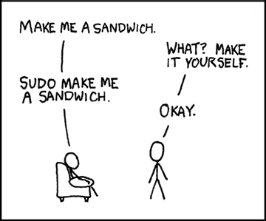

Slide 43
shutdown (Must be root user or use sudo)
Shuts the system off
‘shutdown -r’ reboot the machine
‘shutdown -h now shutdown now without delay
‘shutdown 7:00’ schedule shutdown for 7AM
‘shutdown -c’ cancel pending shutdown

Slide 44
cat : Concatenate
Reads and displays data from a file
‘cat filename’ prints the contents of filename to the terminal
‘cat filename1 filename2’ prints the contents of both files back to back to the terminal
‘cat filename1 > filename2’ copies the contents of filename1 to filename2
‘cat filename1 >> filename2’ copies the contents of filename1 to the end of filename2 (appends / concatenate)

Slide 45
File-related commands
cp - copy, e.g. cp existing_file new_file
mv - move, e.g. mv original_file new_file
rm - remove file
mkdir - make directory
rmdir - remove empty directory

Slide 46
How to find files
find - find files on system (slow), e.g. find / -name filename
locate - find files on system from an index (fast), e.g. locate filename

Slide 47
grep
Searches for a specific piece of text in a file
grep “Pete” baltimoresbest.txt
grep -i “pete” baltimoresbest.txt
The -i tells grep to search but make it case insensitive (PETE, pete, PeTe)
grep -ir “pete” *
This will search for ‘pete’ (case insensitive) in all files and will recurse (-r) through all subsequent directories

Slide 48
Commands (cont)
Most linux commands have flags to give more information or provide output in a desired Format. Flags can also be combined for further output refinement.
Example:
ls -al /home/bob
ls shows the files in Bob’s home directory
-a shows all files including hidden files in the directory
-l shows the long listing of the file including owner, file permissions, size

Slide 49
Mounting filesystems
Devices (hard discs, DVDs, etc) cannot be accessed directly. They must be “mounted” to the filesystem. Network shares can also be mounted. Mount settings saved in /etc/fstab.
Mount - mounts a device to filesystem, e.g. mount /dev/cdrom /media/cdrom (if not in fstab), e.g. mount /media/cdrom (if in fstab)
Umount - unmounts device, e.g. umount /media/cdrom
/dev/mmcblk0 - SD Card (used for storage on Raspberry Pi)
/dev/mmcblk0p1 - Partition 1 (boot files)
/dev/mmcblk0p2 - Partition 2 (OS and user files)
/dev/sda - USB or SATA drive
/dev/sda1 - Partition 1
Notes:
Mounting lets you access the drive. DMSG tells what it is assigned to…….

Slide 50
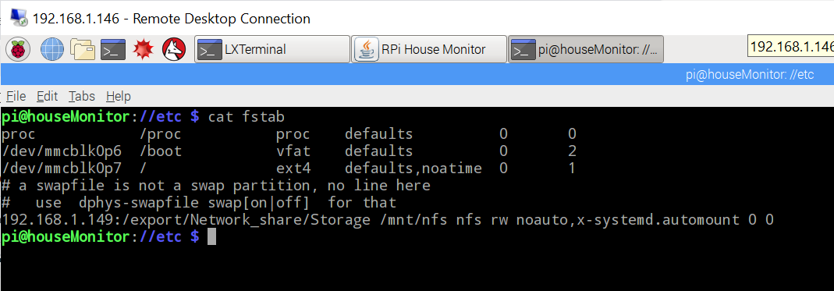

Slide 51
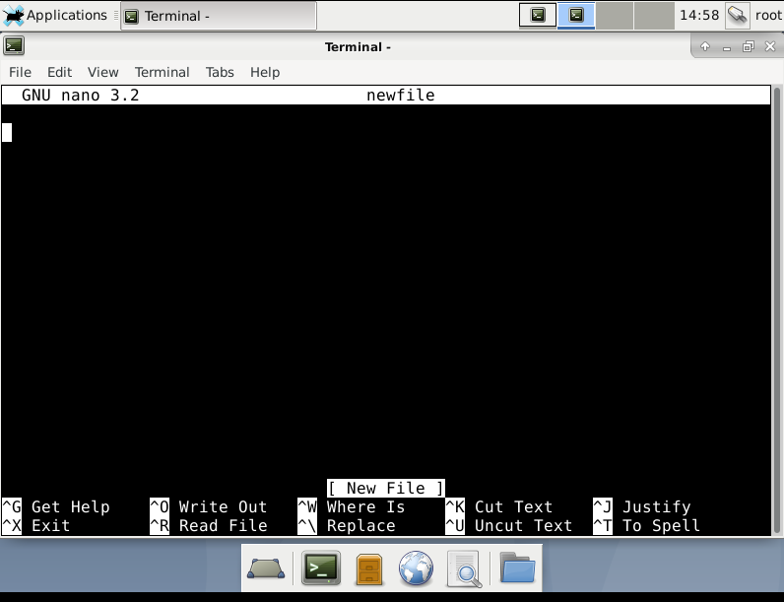
Newbie friendly
text editor
“Easy” to use editor called nano
Arrow key driven
Ctrl & o to write file
Ctrl & x to exit

Slide 52
Scripting
https://www.linux.com/training-tutorials/writing-simple-bash-script/
#!/bin/bash
echo “Wait for 5 seconds”
sleep 5
echo “Completed”

Slide 53
How to Download/Install Software
Most Linux distros manage software installations and updates through packages (e.g. .rpm, deb files)
  APT - Raspberry Pi OS, Ubuntu, Debian
  APTITUDE - Raspberry Pi OS, Ubuntu, Debian
  YUM/DNF - Fedora, Red Hat
Repositories (repo) - Servers that host the software packages
Package managers download requested software, updates, and dependencies
Check Add Remove Software! Let the computer do it for you!

Slide 54
How to Download/Install Software
Raspberry Pi OS examples:
  sudo apt update - downloads the current list of software from repo
  sudo apt upgrade - downloads and updates installed software with the latest versions
  apt search <software package> - searches the repositories for packages containing this search term
  sudo apt install <software package> - installs the package (and dependencies)

Slide 55
How to Download/Install Software
Raspberry Pi OS examples:
pi@piZero:~ $ sudo nano /etc/apt/sources.list
deb http://raspbian.raspberrypi.org/raspbian/ buster main contrib non-free rpi
# Uncomment line below then 'apt-get update' to enable 'apt-get source'
deb-src http://raspbian.raspberrypi.org/raspbian/ buster main contrib non-free rpi

Slide 56
How to Download/Install Software
Raspberry Pi OS examples:
pi@piZero:~ $ sudo apt update
. whole bunch of stuff prints here….
pi@piZero:~ $ sudo apt upgrade
. whole bunch of stuff prints here….

Slide 57
How to Download/Install Software
pi@piZero:~ $ sudo apt install aptitude -y
. whole bunch of stuff prints here….
pi@piZero:~ $ sudo aptitude upgrade
. whole bunch of stuff prints here….
pi@piZero:~ $ sudo aptitude dist-upgrade -y
. whole bunch of stuff prints here….
pi@piZero:~ $ sudo aptitude autoclean
. whole bunch of stuff prints here….

Slide 58
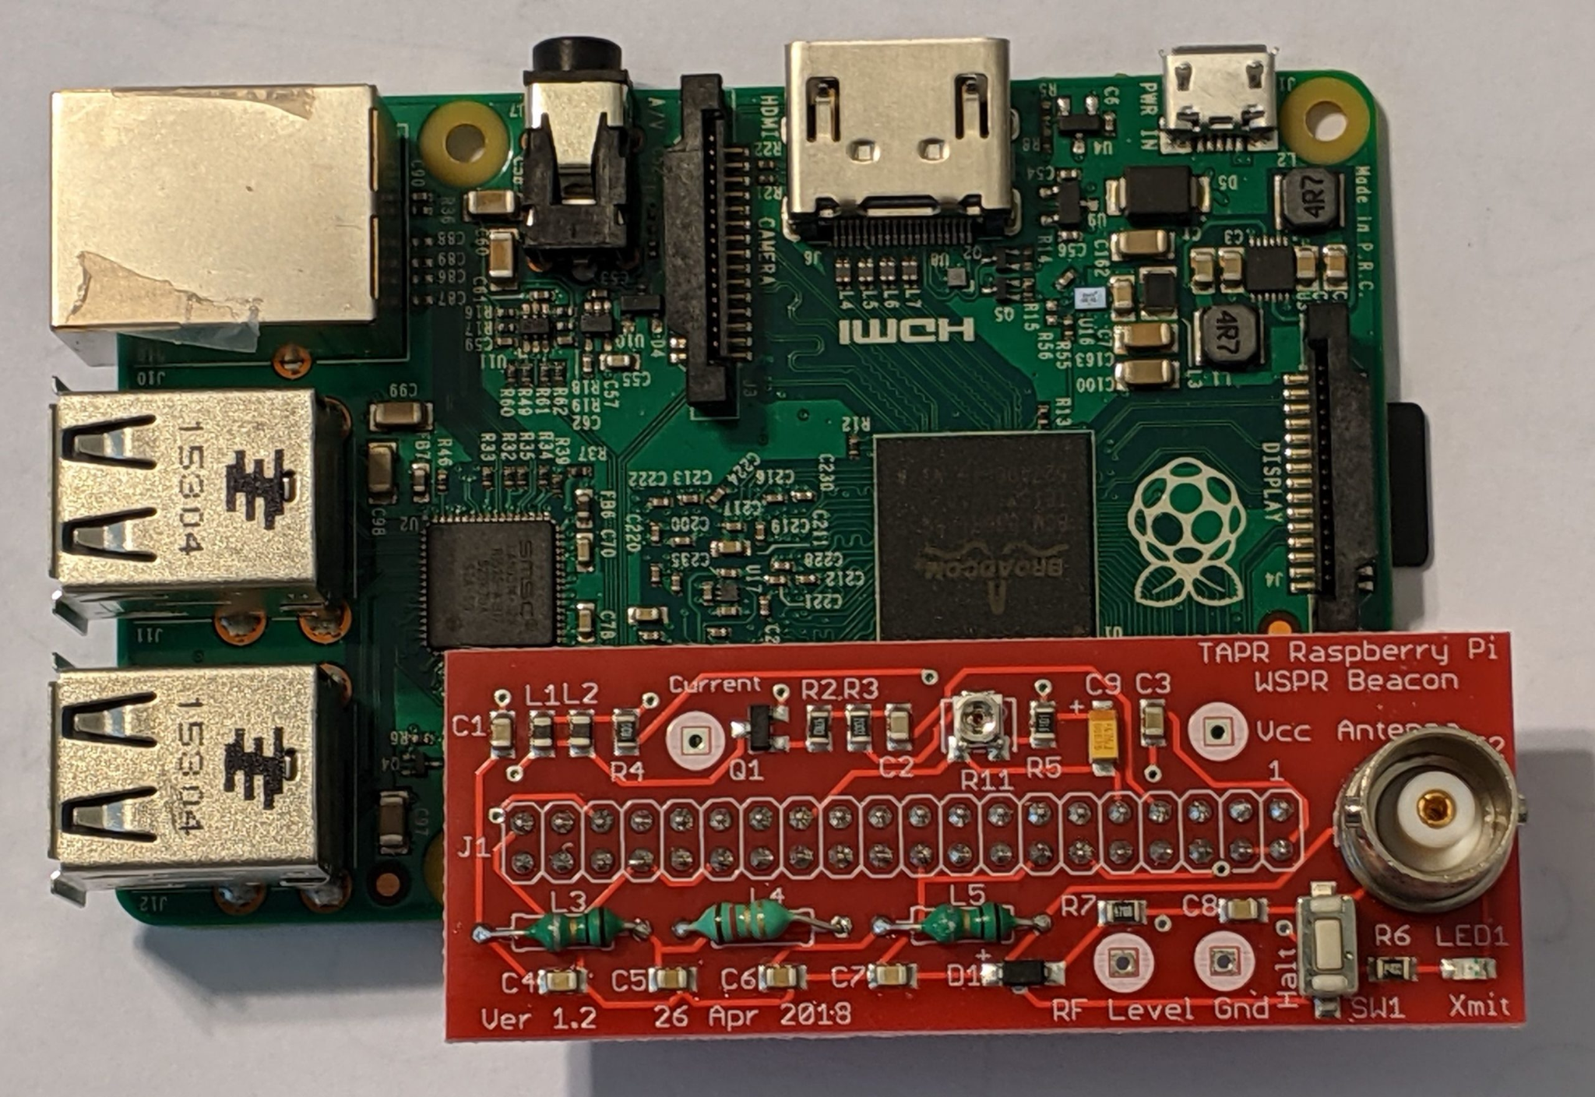
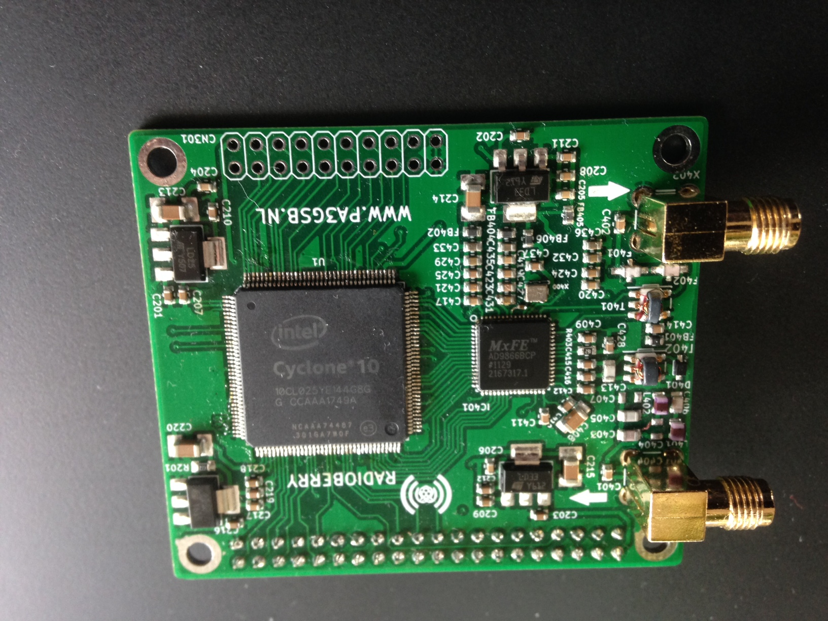
Applications
Radioberry kernel module - SDR radio (A hat!)
MotionEyeOS - Camera /security software
OpenMediaVault - File server
Octopi - 3D Printer service as single distro
HAMPi - OS & applications as a single distro
WSPR from TAPR (A hat!)
DNS Server
Notes:
Some are more out of the box than others. Motioneye is an OS so you just install it on the SD card. OpenMediaVault runs on the Pi OS but if you are playing with a radioberry board, you will need to download and compile it. Fortunately, this is very easy and steps are published.

Slide 59
Programming Options
Python
C, C++
Java

Slide 60
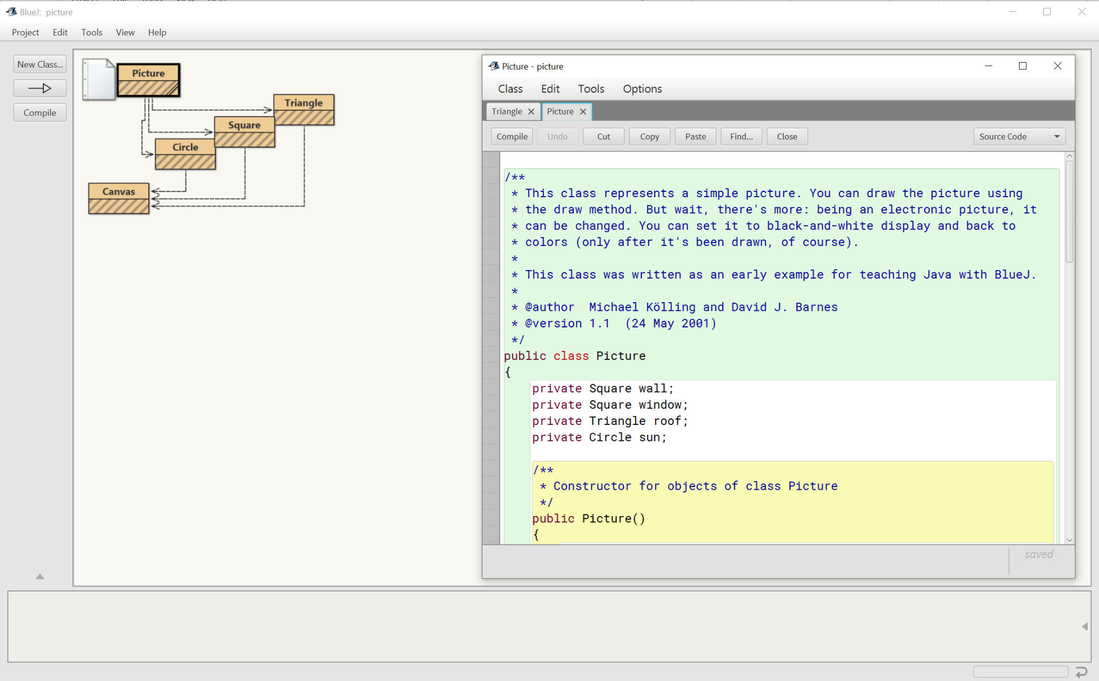
Integrated Development Environment (IDE)
BlueJ
Notes:
Very slow on newer versions. According the BlueJ developers, this is due to the Raspberry Pi developers not fulling integrating BlueJ into the modern OS.

Slide 61
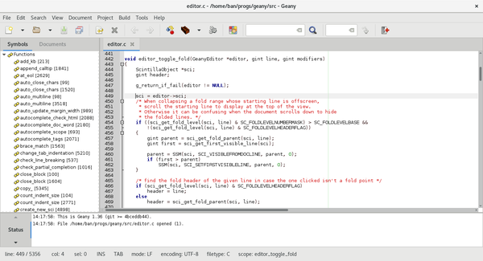
IDE
Geany
Lightweight text editor
C
C++
Java

Slide 62
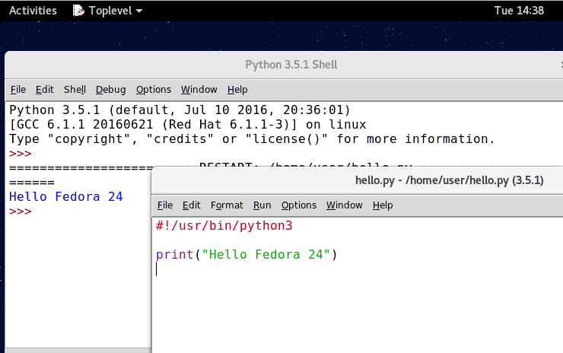
IDE
IDLE
Python

Slide 63



Programming Options

