Slide 1
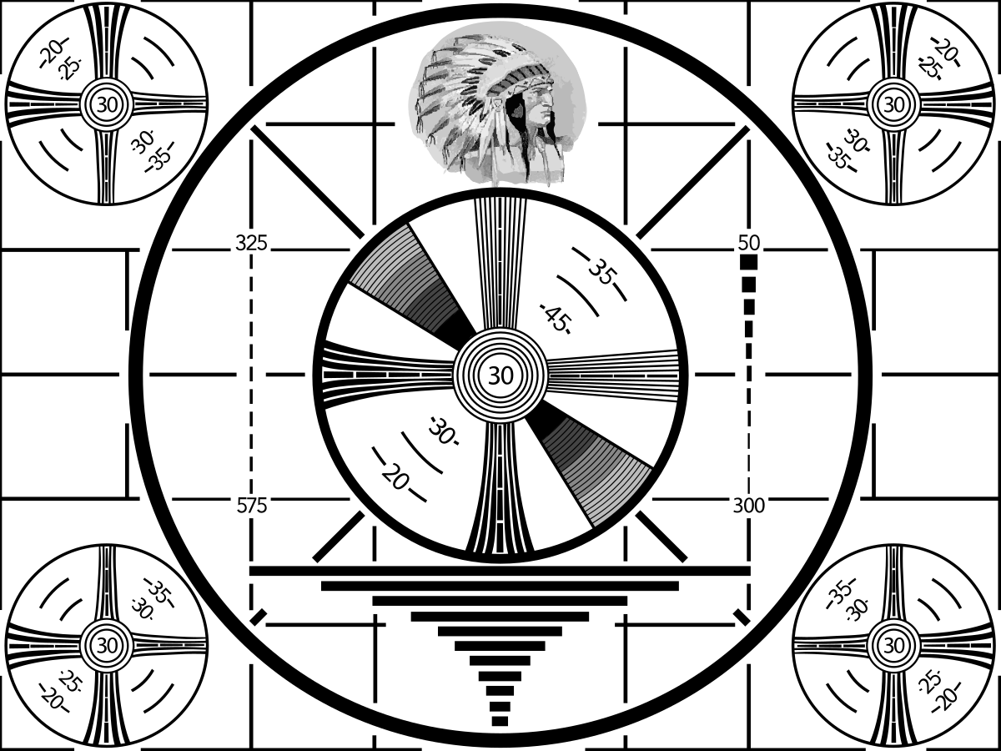

Slide 2
Node-red, MQTT, Mosquitto, Tasmota Pi stuff and more!
The internet of things (IOT) is an exponential advance in the way we use existing technology and a stepping stone to what is being developed for the future
Transferring information wirelessly from and to intelligent devices in the home is becoming commonplace
This is a brief overview of what can be done today with existing H/W and minimal cost.

Slide 3


Slide 4


Slide 5

Hedy Lamarr 1914-2000

Slide 6
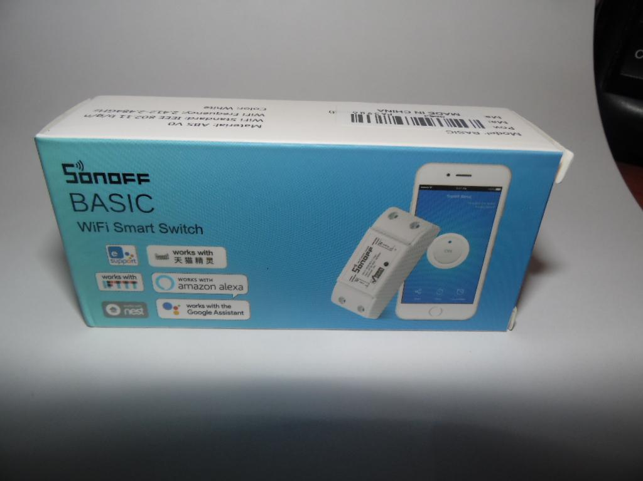
Sonoff Basic

Slide 7
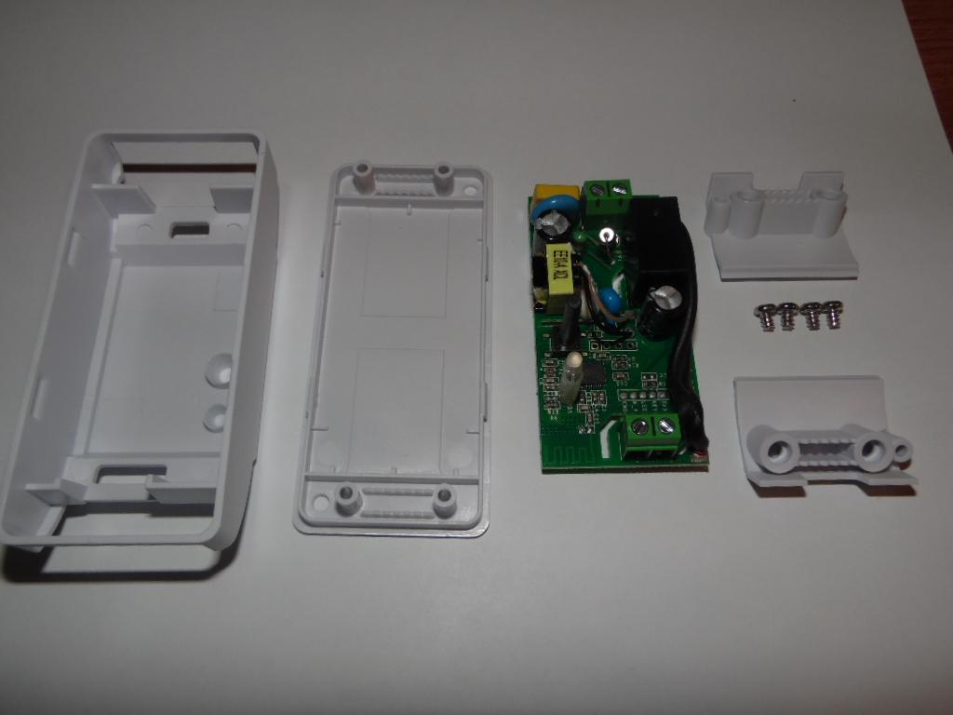

Slide 8
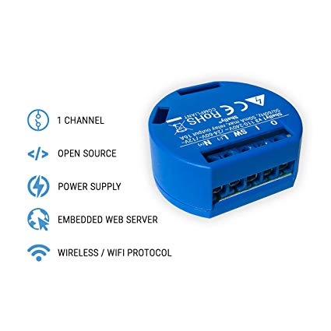
Shelly
Shelly is more hacker-friendly as it has program headers already installed
designed to be used inside a power box.

Slide 9
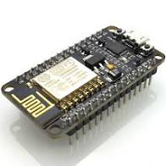
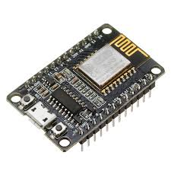
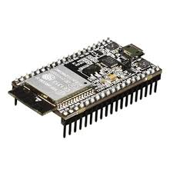
The ESP8266 is a low-cost Wi-Fi microchip with
microcontroller capability by Espressif Systems in China.
ESP8285 is an ESP8266 with 1 MB of built-in flash
The ESP32 is dual core 160MHz to 240MHz CPU whereas the ESP8266/8285 is a single core running at 80MHz. The ESP32 also has bluetooth and more interface capabilities.
CAN bus, hall effect, touch sensors etc.

Slide 10
In general, programs written for one chipset can be run on another. All of these can run micropython if that is your program of choice.

Slide 11
TASMOTA:
Acronym for Theo Arends Sonoff MQTT Over The Air. A Robust replacement for pre-programmed control devices. Supports local, web-based control, and HTTP control, it has built in timers, logging functions, configurable GPIO pins and MQTT capabilities.

Slide 12
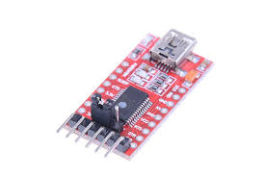
Flashing is done with a FTDI adapter connected to programming pins. 4 pins
are used, plus, minus, Tx and Rx. If you have a Raspberry Pi, it can be used
as a programmer (save $1.25)
The chip is read and the MAC address saved, then the original SW is backed up
to a file, then it is erased and programmed. Takes about 5 minutes to do everything.

Slide 13
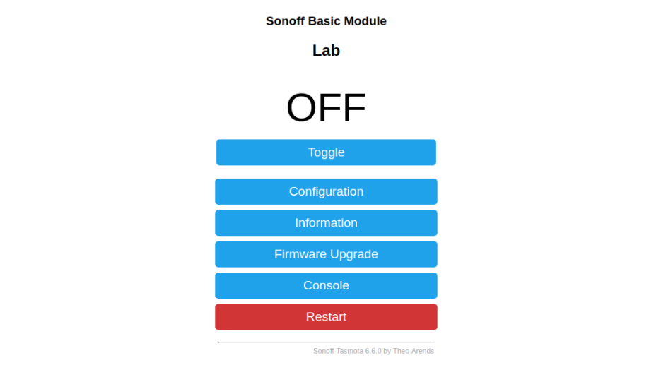
Browse to 192.168.4.1 and get the main screen for the Sonoff device

Slide 14
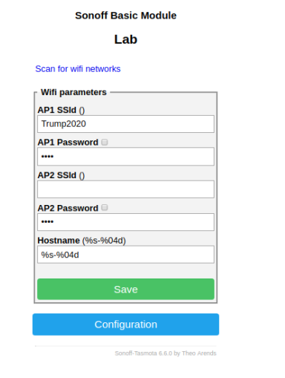
Go to Configuration and select the Wifi tab. Enter the ssid and password and reboot, then use your main Wifi connection to get a DHCP IP.
Reboot and test through web address, then make IP static.

Slide 15
MQTT is a bi-directional signalling protocol developed in 1999 by Andy Stanford-Clark from IBM
The acronym stands for Message Queuing Telemetry Transfer
It uses a hub, called a broker to manage traffic initiated or sent to network nodes called clients.
A message is said to be ‘published’ when it is sent out to one or many clients.
A client can subscribe to a published topic or not, as the case may be. There can be limitless topics, clients, and publishers. (Within reason)
The published topic contains a message called a payload and its contents are acted on or ignored accordingly by the client, or the broker.

Slide 16
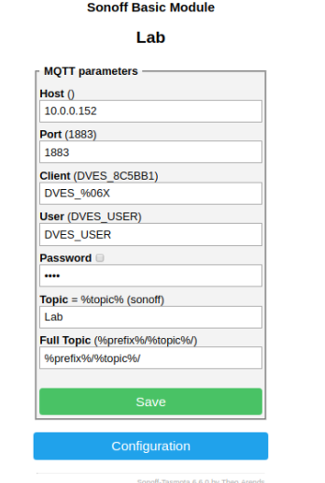
Enter the IP of the broker PC, then select a name to be used for the topic. The port address can remain as default. Enter a password if desired.

Slide 18
Implementation of MQTT
Mosquitto is popular and available on many platforms, it is not installed by default on Raspbian.
Node-red has a MQTT contributed-node available.
Python has an MQTT component which we will visit next.

Slide 19
Python program utilizing mqtt module
import paho.mqtt.client as mqtt #import the client
import time
from datetime import datetime
from w1thermsensor import W1ThermSensor
sensor = W1ThermSensor()
x = chr(176) # this is the degree symbol
broker_address="10.0.0.152"
client = mqtt.Client("temperature") #create new instance
client.connect(broker_address) #connect to broker
# while True:
celc = sensor.get_temperature()
celsius=round(celc,2)
tempf=celsius*9/5+32
tempf=round(tempf,2)
print("The temperature is",celsius,x,"C")
print("The temperature is",tempf,x,"F")
now=datetime.now()
print (now)
client.publish("temperature",(tempf))
exit()

Slide 20
@reboot sleep 120 && nohup ~/fish.sh &
#!/bin/bash
while:
do
python3 fishtank.py
sleep 5m
done

Slide 21
I INSTALLING MOSQUITTO
sudo apt-key add mosquitto-repo.gpg.key. ...
cd /etc/apt/sources.list.d/ ...
sudo wget http://repo.mosquitto.org/debian/mosquitto-wheezy.list. ...
sudo wget http://repo.mosquitto.org/debian/mosquitto-wheezy.list. ...
sudo -i. ...
apt-get update. ...
apt-get install mosquitto.
Stat mosquitto with – mosquitto -v
Stop with sudo service mosquitto stop

Slide 22
Node-Red
Written by Paul Morrison in the 1970s as a way of describing
the behavior of black boxes connected to a network. It is written
in Javascript and was developed by IBM. It is included as an application
menu choice on RPi distributions from Rpi.org.
It allows you to connect nodes, debug them and modify their behavior programmatically It has become open source and has over 2700 standard
and user-contributed nodes.
There is a dashboard feature that allows interaction with the program
with a web interface that can be used on a computer, android, or smart phone.

Slide 23
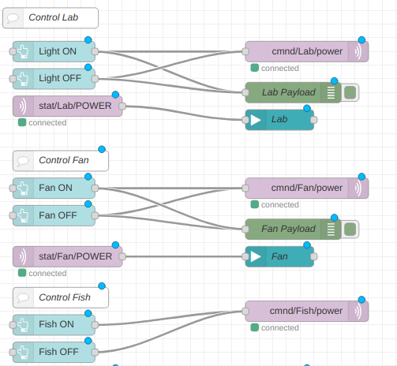

Slide 24





