Slide 1

Tony / KF3AK
Jeff / N3JET

Slide 2
Overview
What is Winlink?
Who uses it?
How to access it?
Where do we go from here?

Slide 3
Winlink
Global Radio Email
What is Winlink?

Slide 4
A Brief History of Data Comms
(Treat as “Alternative Facts”)

Slide 5
A Brief History of Data Comms
(Treat as “Alternative Facts”)
CW, RTTY (non-error-correcting “WYHIWYG”)

Slide 6
A Brief History of Data Comms
(Treat as “Alternative Facts”)
CW, RTTY (non-error-correcting “WYHIWYG”)
Automatic Repeat Request (ARQ) Data Protocols
  Assured accuracy
  X.25 packet switching (think “banking, ATMs” and, later, the Internet)

Slide 7
A Brief History of Data Comms
(Treat as “Alternative Facts”)
CW, RTTY (non-error-correcting “WYHIWYG”)
Automatic Repeat Request (ARQ) Data Protocols
  Assured accuracy
  X.25 packet switching (think “banking, ATMs” and, later, the Internet)
X.25 was adapted for amateur radio as AX.25
  Became “Packet”
  Dumb terminal/TNC (the “smarts”)/Transceiver
  BBSs and mailboxes abounded
    Text-only transfers
    Generally 1200 baud VHF/FM
    Assured accurate transfers
    CCARC hosted a BBS

Slide 8
A Brief History … Cont’d.
(Treat as “Alternative Facts”)
Along came the Internet
  “Invented by Al Gore” (So it was claimed)
    (The internet was actually created/developed over decades)
  Wide World Web was invented by Tim Berners-Lee (he developed the browser concept)
What do you think happened to Packet?

Slide 9
A Brief History … Cont’d.
(Treat as “Alternative Facts”)
Along came the Internet
  “Invented by Al Gore” (So it was claimed)
    (The internet was actually created/developed over decades)
  Wide World Web was invented by Tim Berners-Lee (he developed the browser concept)
Amateur packet went “Poof” and all but disappeared!

Slide 10
Winlink (aka WL2K)
Arose from the ashes of the BBSs

Slide 11
Winlink (aka WL2K)
Arose from the ashes of the BBSs
Embraced the Internet

Slide 12
Winlink (aka WL2K)
Arose from the ashes of the BBSs
Embraced the Internet
Added Graphical User Interface (GUI)

Slide 13
Winlink (aka WL2K)
Arose from the ashes of the BBSs
Embraced the Internet
Added Graphical User Interface (GUI)
Accommodated multiple protocols
  Packet, Pactor, Winmor, (and Others)

Slide 14
Winlink (aka WL2K)
Arose from the ashes of the BBSs
Embraced the Internet
Added Graphical User Interface (GUI)
Accommodated multiple protocols
  Packet, Pactor, Winmor, (and Others)
Introduced Email-Over-Radio

Slide 15
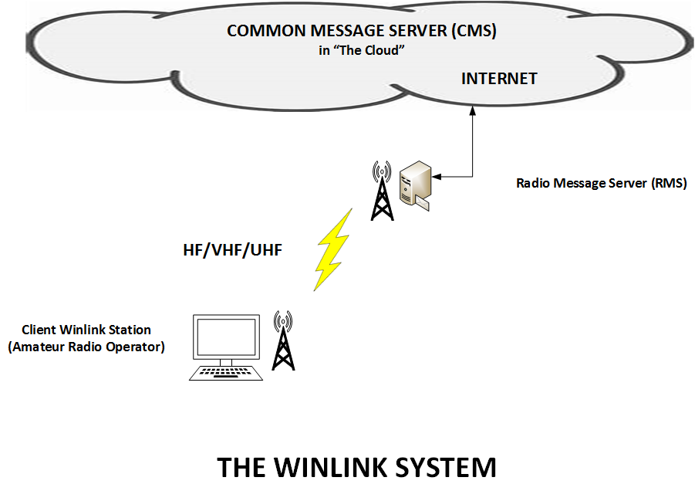
Notes:
The CMS no longer exists. It has been replaced with Amazon Web Services server system (AWS). The graphic still accurately portrays the “cloud”.

Slide 16
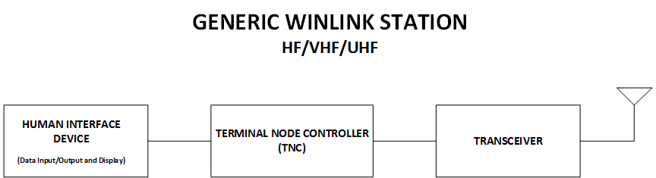

Slide 17
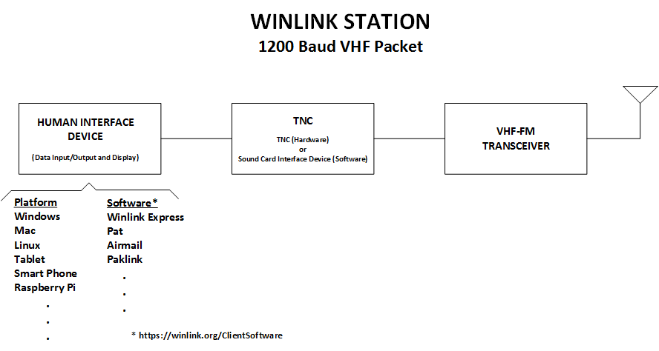

Slide 18
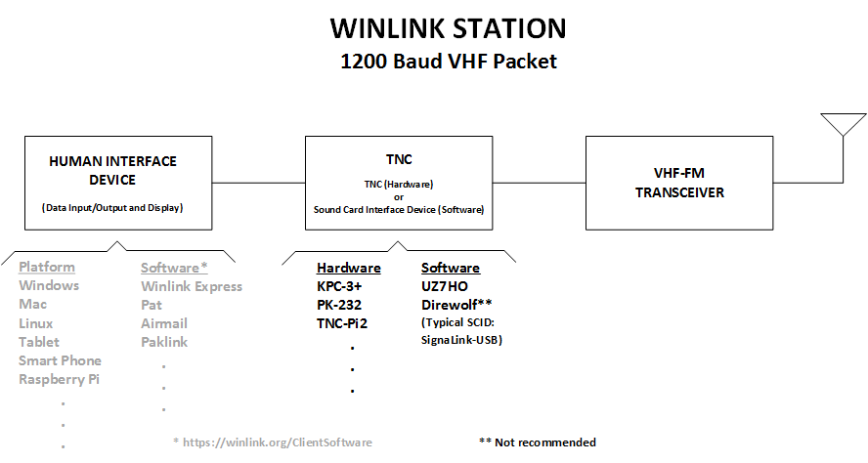

Slide 19
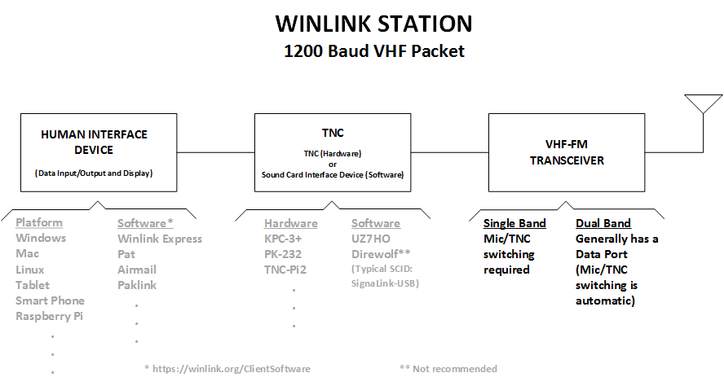

Slide 20
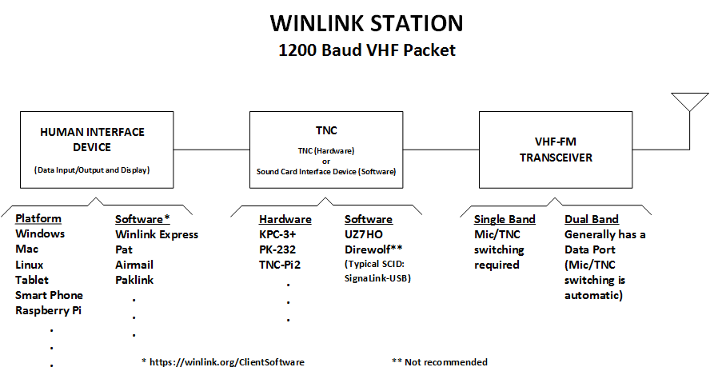

Slide 21
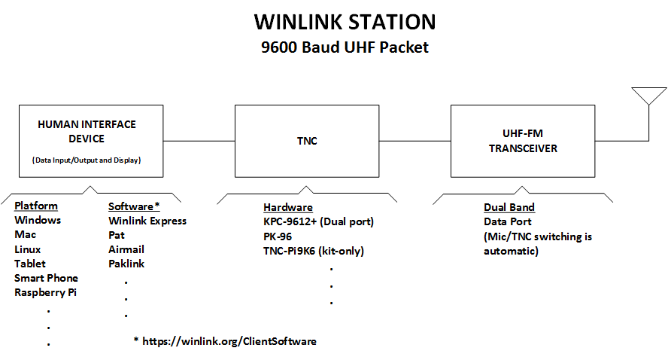

Slide 22
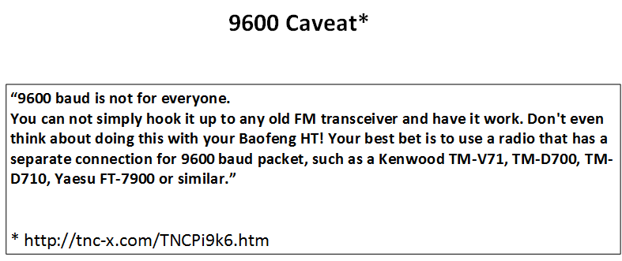

Slide 23
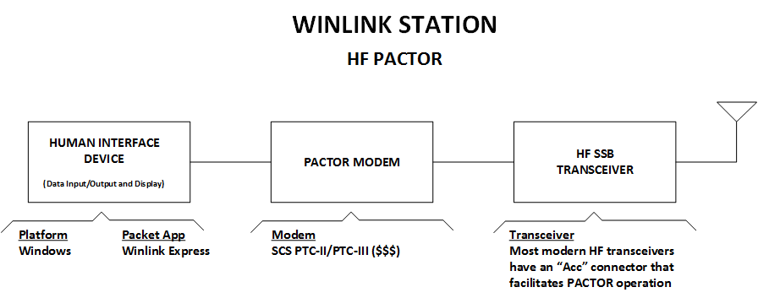

Slide 24
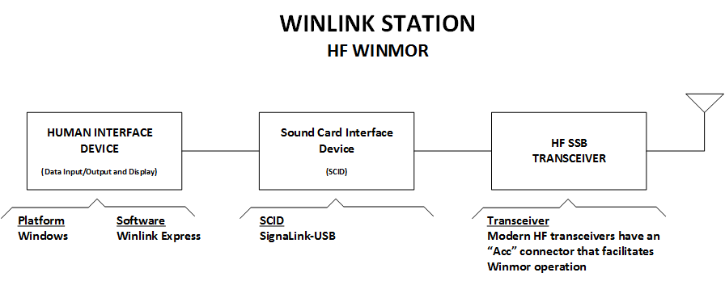

Slide 25
Winlink
Global Radio Email
Who uses winlink?

Slide 26
Who uses WL2K?
Licensed Amateur Radio Operators
Notes:
Important to emphasize only properly licensed Amateur Radio licensees can use WL2K on amateur frequencies.
EXAMPLES
Seagoing operators, often licensed with a ship’s, marine or general radiotelephone license, also require at least a General Class amateur radio license to use Winlink, as it operates on the amateur radio bands, NOT the marine bands.
National Traffic System – any HAM station may forward and insert properly formatted Radiogram message traffic to NTS regional liaisons. There are a few tools to assist in composing Radiograms, the first is embedded within the software Winlink Express. Another is the NTSD Parser, a more robust tool is a stand alone program by Joe Tracey, KB3LNM.

Slide 27
Who uses WL2K?
Licensed Amateur Radio Operators
Government & NGO Public Service Orgs
Notes:
Depending on the operator, frequencies outside the Amateur Radio Bands may be used.

Slide 28
Who uses WL2K?
Licensed Amateur Radio Operators
Government & NGO Public Service Orgs
Medical & Humanitarian Non-Profits
Notes:
Red Cross
Salvation Army
Austrian Red Cross
UK Cadet program

Slide 29
Who uses WL2K?
Licensed Amateur Radio Operators
Government & NGO Public Service Orgs
Medical & Humanitarian Non-Profits
EmComm Organizations
Notes:
ARES/RACES
I used WL2K following Carroll County Hospital’s July COMMEX to forward ICS-213 and -214 reports to Steve / N3SB using John Ohm’s / W8IS RMS Packet station. Alternatively, I could have used WN3R Packet Station (Frederick) or arranged a Peer-to-Peer message traffic exchange with Steve.

Slide 30
Who uses WL2K?
Licensed Amateur Radio Operators
Government & NGO Public Service Orgs
Medical & Humanitarian Non-Profits
EmComm Organizations
MARS / SHARES

Slide 31
Who uses WL2K?
Licensed Amateur Radio Operators
Government & NGO Public Service Organizations
Medical & Humanitarian Non-Profits
EmComm Organizations
MARS / SHARES
You!!!
Notes:
Add Winlink to your shack and Go Kit! Learn how to and be ready to use it.
Technician Licensees can access via Telnet and VHF Packet. General Licensees and above can use all access modes.

Slide 32
Winlink
Global Radio Email
How to access wl2k?

Slide 33
How to access WL2K?
Get an Account
1. Visit http://www.winlink.org/user for instructions to create your account.
2. Download Winlink Express: http://www.winlink.org/RMSExpress
3. Watch this video: http://www.winlink.org/content/k4ref_how_to_video_series_winlink_rms_express
4. Read the program help files and configure it.
5. Use 'Telnet' sessions to practice and experiment until you can set up your radio installation.
Notes:
Don’t worry about copying the links. The presentation will be available on the club’s website.
You cannot create an account online. You are required to send a message (to anyone) via Winlink. Send it to me, N3JET.

Slide 34
How to access WL2K?
How to Send Email to Winlink Address
Notes:
Generally speaking, outbound messages only require standard email address formatting. Messages addressed to Winlink stations require a little more information.

Slide 35
How to access WL2K?
How to Send Email to Winlink Address
Addressing
  From within Winlink
    Example - TO: N3JET
Notes:
Of course there are exceptions.
From within Winlink to another Winlink station – just place the amateur call in the TO: block

Slide 36
How to access WL2K?
How to Send Email to Winlink Address
Addressing
  From outside of Winlink
    Example - TO: N3JET@winlink.org
            Subj: //WL2K {Subject}
Notes:
Unless the sending station email address has already been White Listed, the Subject line requires the //WL2K.
The "//WL2K" key informs the mail processing system to bypass the anti-spam whitelist (accept list) and allow the message to be forwarded to the Winlink user should the recipient address be absent from the receiving account whitelist. This key may be changed from time-to-time.

Slide 37
How to access WL2K?
How to Send Email to Winlink Address
Addressing
SPAM Control
Notes:
Why is the spam filter so important?
SPAM control on the WL2K system is essential because licensed radio operators are bound by laws and regulations that prohibit commercial or indecent content contained in most unexpected messages. More importantly, slow radio circuits could be easily clogged with SPAM messages when important, urgent or emergency messages must get through.
Each account has a WHITEList and BLACKList
WHITEList contains a list of email addresses or domains that will be accepted. Addresses are automatically WHITELISTED when used in outgoing email.
BLACKList contains addresses or domains that will be rejected.

Slide 38
How to access WL2K?
How to Send Email to Winlink Address
Addressing
SPAM Control
File Size
Notes:
120,000 bytes compressed, but …
What type of file attachments?
- Many types are permitted but some types comes with significant overhead. Overhead can be minimized by using .txt, .rtf, or .csv attachments as appropriate. Image files should be as small as practical.
If you’re thinking of sending large attachments with Winlink, consider this: If a 4KB Winlink message takes approximately 2 minutes to send over 1200 baud packet, a 120 KB message, the largest possible Winlink message size, would take about an hour!
ARES typically recommends no more than 5KB Winlink messages.

Slide 39
How to access WL2K?
How to Send Email from Winlink
Addressing
  From Winlink to anywhere
    Example - TO: N3JET@ARRL.net
    May enter multiple addresses, CC and BCC
Notes:
Just like any other email system. File Size limitations still apply.

Slide 40
How to access WL2K?
Client Programs
Outpost
AirMail
Pat
PacLink
Winlink Express
Notes:
The Winlink.org website provides an excellent comparison tool to help you decide which program(s) are best for your situation. Various programs provide one or more methods to access WL2K assets, all based on your current operating capabilities.

Slide 41
How to access WL2K?
Access Via
TELNET (TCP/IP)
ALE
APRS
D-Star
AX.25 Packet
PACTOR (I, II, III, IV)
WINMOR
ARDOP
VARA
*Webmail
Notes:
I regularly use TELNET, Packet, PACTOR III and Winlink Webmail. WINMOR is another popular way to access Winlink. Options provide situational flexibility.
Generally I reserve TELNET ops for updating Winlink Express help files, frequency databases and propagation predictions. Packet and PACTOR are used when handling message traffic (Radiograms).
I use Winlink’s Webmail facility to check for messages waiting for download. It’s useful when traveling or deciding if I have to return to the shack for priority traffic. If messages require priority handling or of a personal nature I will respond immediately as required, via webmail.

Slide 42
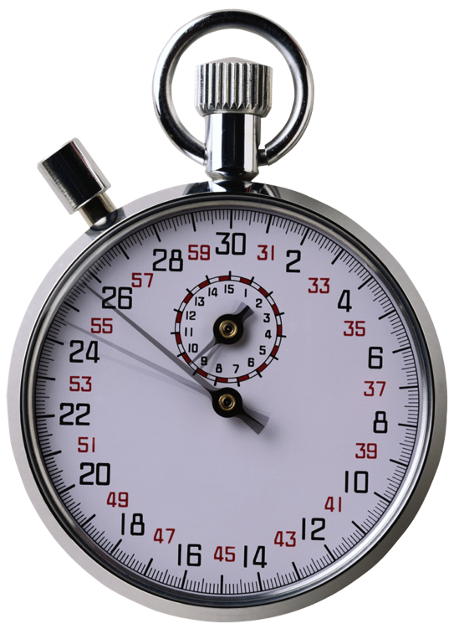
The Skinny on Modes
Approximate air times needed to transfer a 4K message (after compression) under ideal conditions:
Packet (1200) direct 2 minutes
Packet (9600) direct 1 minute
Pactor 1 15 minutes
Pactor 2 4 minutes
Pactor 3 30 seconds
Pactor 4 15 seconds
WINMOR 500 10 minutes
WINMOR 1600 3 minutes
Telnet seconds
Notes:
FAQ about Winlink 2000 / Winlink.org – Q&A Question 170
PACTOR 4 transmissions … FCC waiver required – Hurricane relief efforts in 2017 & 2018
are not generally legal for US amateurs due to bandwidth and symbol rate attributes. In October 2017, FCC granted an ARRL request to waive Amateur Radio rules to permit data transmissions at a higher symbol rate limited to Amateur Radio operators in direct hurricane relief involving Puerto Rico and US Virgin Islands² and again in August 2018 for Hawaii’s Hurricane Lane Relief Efforts³.

Slide 43
Winlink
Global Radio Email
Where do we go from here?

Slide 44
Where Do We Go From Here?
Become an Operator (Winlink Client) on VHF/UHF-FM Packet
    VHF – Local (Near-LOS)
    UHF – Very local (LOS)
Notes:
Clients may also access via other modes.

Slide 45
Where Do We Go From Here?
Become an Operator (Winlink Client) on HF SSB
  Pactor, Winmor (and others)
  Span hundreds, perhaps thousands, of miles

Slide 46
Where Do We Go From Here?
Become a RMS System Operator (Sysop)
  Same hardware as Client Operator
  Add Internet connection
  Operate 24/7
  RMS registration and software issued by the Winlink 2000 organization (There are no fees)
  Club member John W8IS operates a 1200 baud VHF-FM RMS in Taylorsville
    W8IS-10/145.090 MHz (simplex)
    The ONLY RMS in Carroll County

Slide 47
Resources
Winlink.org
Radio-Relay.org – Radio Relay International
SCS-PTC.com – the Pactor modem company
ARRL General Class License Manual, Ch 6
YouTube > “Sound Modem TNC for VHF Packet in Winlink Express”
YouTube > “K4REF” (complete RMS Express training series)
YouTube > “HF Pactor connection to Winlink demo” by Commsprepper
Packet Radio > wiki.complete.org/PacketRadio

Slide 48
Citations
¹ https://winlink.org/content/quick_start_links_mariners_and_everyone
² ARRL.org – FCC Grants Temporary Waiver to Permit Higher Symbol Rate Data Transmissions, 10/05/2017
³ ARRL.org - FCC Grants Temporary Waiver for Hurricane Lane Relief Efforts, 8/24/2018

Slide 49
Questions?
Tony - KF3AK@Winlink.org
KF3AK@ARRL.net
Jeff - N3JET@Winlink.org
N3JET@ARRL.net

Slide 50
Questions?
Contact Jeff via Winlink!
I check WL2K daily via Packet and Webmail. Feel free to bounce test messages off me.
From within WL2K use TO: N3JET
From standard email TO: N3JET@Winlink.org Subj: //WL2K (subject)

Slide 51
Message ID: WQKZGCADF1GQ
Date: 2018/10/08 21:05
From: SERVICE
To: N3JET
Source: SYSTEM
Downloaded-from: Telnet:cms.Winlink.org
Subject: INQUIRY –
ftp://tgftp.nws.noaa.gov/data/forecasts/marine/offshore/am/amz001.txt
Expires:201810090845;;870665
FZNT23 KNHC 082042
OFFNT3
Offshore Waters Forecast for the SW and Tropical N Atlantic and Caribbean Sea
NWS National Hurricane Center Miami, FL
442 PM EDT Mon Oct 8 2018
Offshore Waters Forecast for the Tropical N Atlantic from 07N to 22N between 55W and 64W, the SW N Atlantic S of 31N W of 65W including Bahamas, and the Caribbean Sea.
Seas given as significant wave height, which is the average height of the highest 1/3 of the waves. Individual waves may be more than twice the significant wave height.
AMZ001-090845-
Synopsis for Caribbean Sea and Tropical N Atlantic from 07N to 19N between 55W and 64W
442 PM EDT Mon Oct 8 2018
.SYNOPSIS...Hurricane Michael near 22.2N 85.2W 978 mb at 5 PM EDT moving N at 8 kt. Maximum sustained winds 70 kt gusts 85 kt. Michael will move to 23.7N 85.7W Tue morning, 25.7N 86.4W Tue afternoon, 27.9N 86.6W Wed morning, inland to 30.2N 85.8W Wed afternoon, and move inland and weaken to a tropical storm near 34.5N 80.5W Thu afternoon. Michael will become extratropical as it moves to 39.8N 68.8W Fri afternoon, and continue to 46.2N 50.0W Sat afternoon. Otherwise and elsewhere, expect moderate trades, diminishing towards the weekend as the pressure gradient slackens even more.
$$

